Slide 1
Vulnerability Assessment and Penetration Testing

Slide 2
PROJECT PROFILE
Project Name: | Vulnerability Assessment & Penetration Testing
Objective | To perform internal and External Vulnerability assessment & Penetration testing
Platform | Web Application
Tools & Technology | Burp Suite Professional v2024.1.1.5, SQLMap, Linux.
Submitted To: | Department of Computer Science, GANPAT UNIVERSITY.

Slide 3

INTRODUCTION
.
1
Vulnerability Assessment and Penetration Testing (VAPT) is a security testing method used by organization to test their applications and IT networks.
2
A Vulnerability Assessment (or vulnerability scan) is an information security process used to identify weaknesses or vulnerabilities in a computer system or network.
3
A Penetration Testing (or pen test) is an authorized simulated attack on a computer system performed to evaluate the system’s security.
4
Vulnerability scanning is performed within the security perimeter and Penetration testing is performed outside of the security perimeter

Slide 4
Overview
Vulnerability Assessment (VA)
Penetration Testing (PT)
A simulated cyber attack to exploit the vulnerabilities identified during the assessment phase. It is often manual or semi-automated, and mimics the tactics of real attackers.
Goal:Confirm exploitability and impact
Example:Exploing week passwords or SQL injection flaws
A systematically scan and detect
security weaknesses using tools
and manual methods.
Goal:Detect Weaknesses
Example:Outdated software
missing patches

Slide 5

Objectives
Our aim
The goal
Using Penetration testing process we are discovering possible vulnerabilities within a website.
The goal of vulnerability scanning and penetration testing is to identify potential weaknesses and attack a website.
Our goal is to better understand an application's behavior and identify vulnerabilities

Slide 6
BACKGROUND & MOTIVATION
.
The concept of Vulnerability Assessment and Penetration Testing (VAPT) emerged from the evolving need to protect digital assets in the face of increasingly complex and frequent cyber threats. With the rise of:
Internet-connected systems
E-commerce and digital services
Data privacy regulations (e.g., GDPR, HIPAA)
Sophisticated cyberattacks (ransomware, phishing, APTs)
organizations realized that traditional security measures like firewalls and antivirus software were no longer sufficient. Hence, a more proactive and offensive approach to security testing was needed — and VAPT became a critical component.

Slide 7
Methodology
Planning & Scoping
Information Gathering
Vulnerabiliy Assessment
Exploitation (Penetration Testing)
Reporting & Remediation
Define the objectives, scope, and type of testing (black box, gray box, white box).
Collect data about the target through passive (e.g., OSINT) and active (e.g., network scanning) methods.
Use automated tools and manual methods to identify known vulnerabilities.
Attempt to exploit the discovered vulnerabilities to demonstrate real-world impact.
Prepare a comprehensive report

Slide 8
3. HARDWARE AND SOFTWARE REQUIREMENTS
Hardware Requirements
Software Requirements
Component | Specification
Processor | CPU/ AMD equivalent
RAM | Minimum 8 GB (16 GB recommended for better performance)
Storage | Minimum 256 GB SSD (500 GB preferred)
Network Adapter | Ethernet & Wi-Fi Adapter with packet injection support
Virtualization | Dedicated GPU for GPU-accelerated tools (e.g., Hashcat)
Support | Required (Intel VT-x or AMD-V)
Category | Tools / Software
Operating System | Kali Linux (Primary), Ubuntu, or Parrot Security OS
Virtualization | VirtualBox / VMware Workstation / Hyper-V
Vulnerability Scanners | Nessus, OpenVAS, Nikto, Nmap
Exploitation Framework | Metasploit Framework, Armitage
Packet Crafting & Sniffing | Scapy, Wireshark, Tcpdump

Slide 9
FUNCTIONAL SPECIFICATION

Slide 10

VAPT
Main function and Advanced Functions

Slide 11


01.Main function of vapt
Main Vulnerability Assessment:
Main Penetration Testing:
This part involves scanning systems, networks, and applications to identify known security weaknesses, misconfigurations, and outdated software.
This goes further by simulating real-world cyberattacks to exploit the identified vulnerabilities. The goal is to determine how deep an attacker could get, what damage they could cause, and how effective current security measures are.
02. Advanced function of vapt
Advanced Vulnerability Assessment
Advanced Penetration Testing
Deep & authenticated scans (using user credentials to reveal hidden issues)
Contextual analysis (business impact, exploitability, asset criticality)
Zero-day & emerging threat detection (through threat intel feeds)
Exploitation of vulnerabilities in a controlled manner to prove real impact
Privilege escalation testing (lateral movement, vertical escalation)
Chained attacks (combining multiple low-risk flaws into a high-impact breach)

Slide 12
TOOLS AND DESCRIPTIONS
1. Nmap
Description:
Nmap (Network Mapper) is an open-source tool used for network discovery and security auditing. It is widely used for identifying live hosts, open ports, services, and the operating system of the target system. During the reconnaissance phase of VAPT, Nmap helps map out the network topology and gain information about potential attack vectors.
Key Features:
Host discovery and service enumeration
OS fingerprinting
Vulnerability scanning integration
2. Nessus
Description:
Nessus is a vulnerability scanner that helps identify known vulnerabilities in the target system, such as misconfigurations, missing patches, and insecure software versions. It uses a large database of known vulnerabilities and can scan both network and web-based targets.
Key Features:
Scans for a wide range of vulnerabilities
Provides detailed reports with risk analysis
Customizable scan templates
3. Metasploit Framework
Description:
Metasploit is one of the most popular frameworks for penetration testing. It allows testers to identify, exploit, and validate vulnerabilities in systems. Metasploit offers a vast library of exploits and payloads that can be used to simulate real-world attacks.
Key Features:
Automated exploitation
Wide range of exploits and payloads
Post-exploitation modules (for maintaining access or data extraction)

Slide 13
4. Scapy
Description:
Scapy is a powerful Python-based tool used for network packet manipulation and analysis. It allows testers to craft custom packets, perform sniffing, and analyze network traffic. Scapy is useful for advanced penetration testing tasks such as bypassing firewalls, conducting DoS attacks, or analyzing protocol vulnerabilities.
Key Features:
Crafting custom packets for network testing
Protocol dissection and analysis
Supports a wide range of network protocols (e.g., TCP, IP, HTTP)
5. Burp Suite
Description:
Burp Suite is an integrated platform for performing web application security testing. It includes a suite of tools like a proxy server, scanner, and intruder for testing web application vulnerabilities such as SQL injection, cross-site scripting, and cross-site request forgery (CSRF).
Key Features:
Intercepting proxy for web traffic analysis
Vulnerability scanner for web applications
Intruder tool for brute-force attacks
6. Wireshark
Description:
Wireshark is a network protocol analyzer that captures and inspects network packets in realtime. It is commonly used during the reconnaissance phase to monitor traffic, detect network vulnerabilities, and identify unauthorized communications or data exfiltration attempts.
Key Features:
Real-time network traffic capture
Deep packet inspection
Detailed analysis of network protocols and their behavior

Slide 14


Slide 15
No. | Vulnerability Name | Severity
1. | HTML Injection | Low
2. | Server Version Disclosure | Low
3. | Denial Of Service Attack | Low
4. | Broken Link Hijacking | Medium
5. | File Upload | Medium
6. | OTP Brute force | High
7. | Authentication By Pass | High
8. | OTP Bypass On Register Page | Medium
9. | SQL Injection | High
10. | Cross Site Scripting (XSS) | High

Slide 16

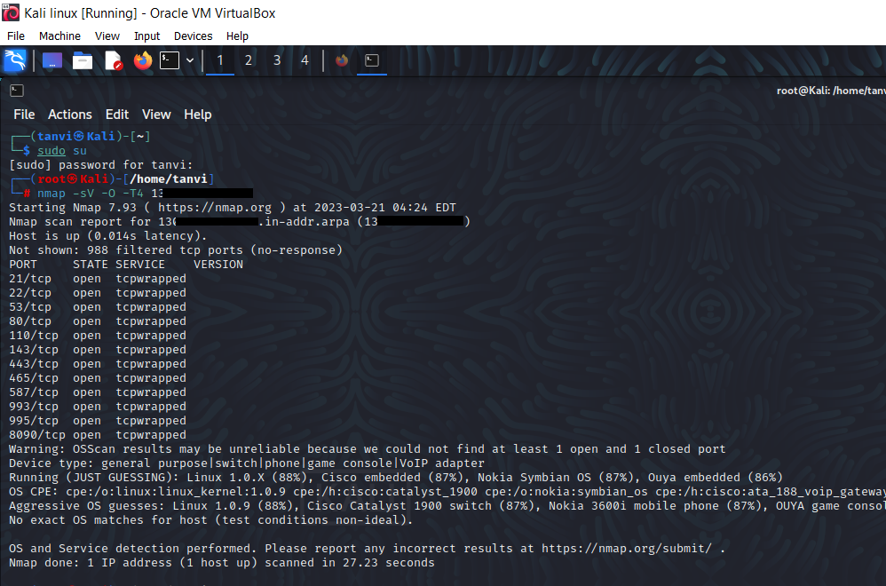
Target site
01
https://www.iphbooks.com/
IP Address :- 13.126.182.130
Vulnerability
02
HTML Injection
Severity
03
Low (https://bugcrowd.com/vulnerability-rating-taxonomy)
Impact
04
An attacker to inject HTML code into web pages that are viewed by other users and allow an attacker to modify the page.
Tools
05
Nmap

Slide 17
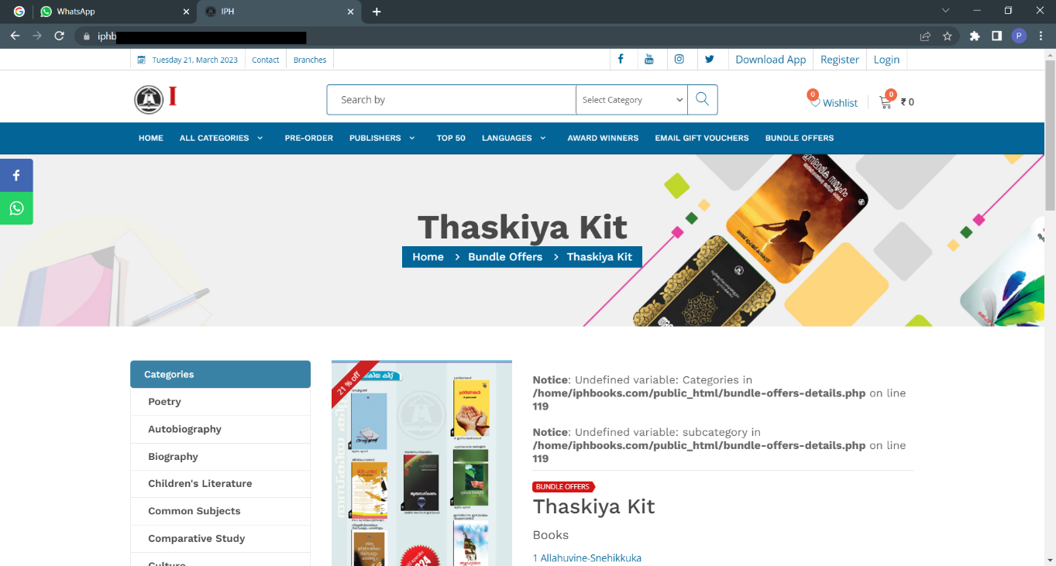
Step 1 :- Visit this site

Slide 18
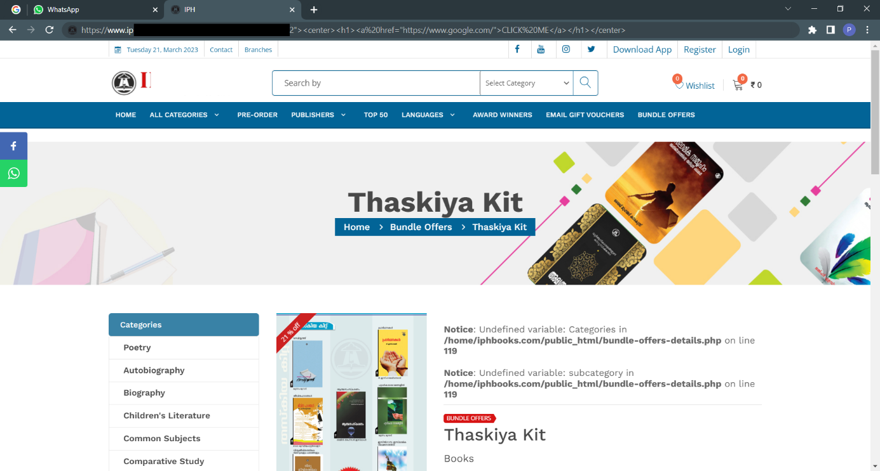
Step – 2: In this URL to write the html code:
”><h1><a href="https://www.google.com/">CLICK ME</a></h1>

Slide 19
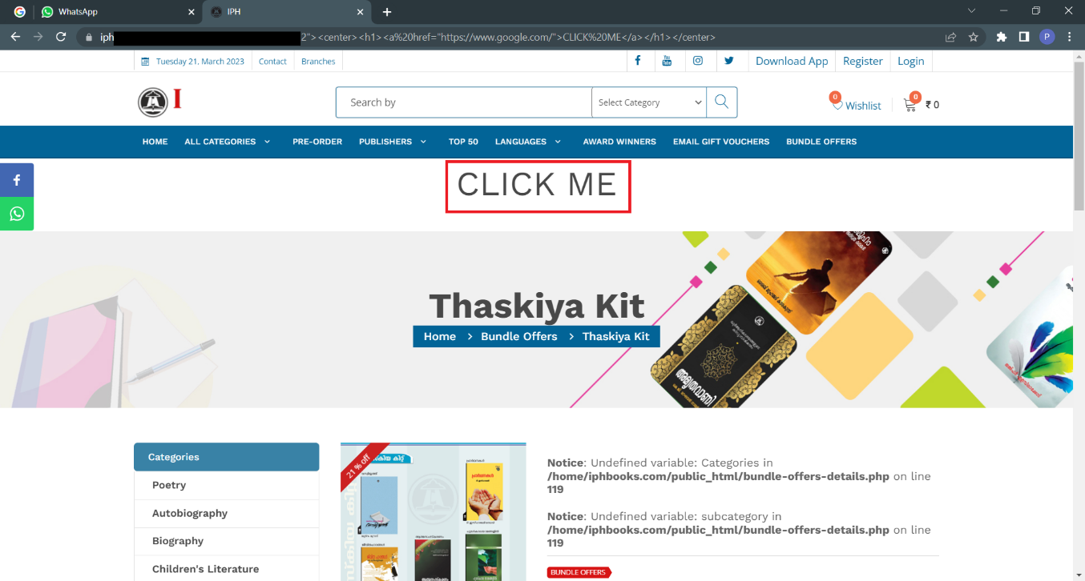
Step – 3: Then Enter and you can see the html code is a reflected-on web page.
Step – 4: We can click the “CLICK ME”.

Slide 20

Step – 5: As a result, we can redirect to the google.

Slide 21
HTML Injection Prevention
This type of Html injection attack occurs when the input and output are not properly validated. So, give proper validation.
Use Post method mainly to hide the URL and the vulnerable parameter from attacker.
Every input should be checked if it contains any script code or any HTML code. Usually, it is checked, if the code contains any special script or HTML brackets – <script></script>, <html></html>.
The main rule to prevent HTML attacks is appropriate data validation.

Slide 22

Target site
01
https://www.iphbooks.com/
IP Address :- 13.126.182.130
Vulnerability
02
Server version disclosure
Severity
03
Low (https://bugcrowd.com/vulnerability-rating-taxonomy)
Impact
04
An attacker can use the disclosed the information to harvest specific vulnerability for the version identified.
Tools
05
Nmap ,Burp Suite

Slide 23
Step 1 :- Visit this site.

Slide 24
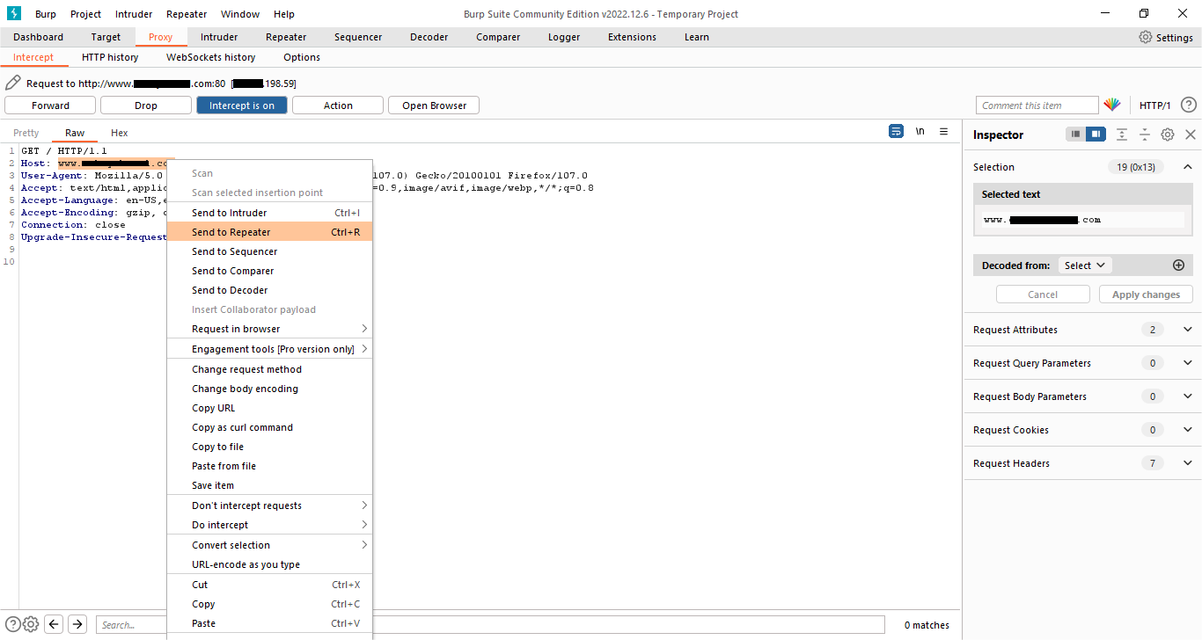
Step 2 :- Here we have capture the request and sent it to Repeater.

Slide 25
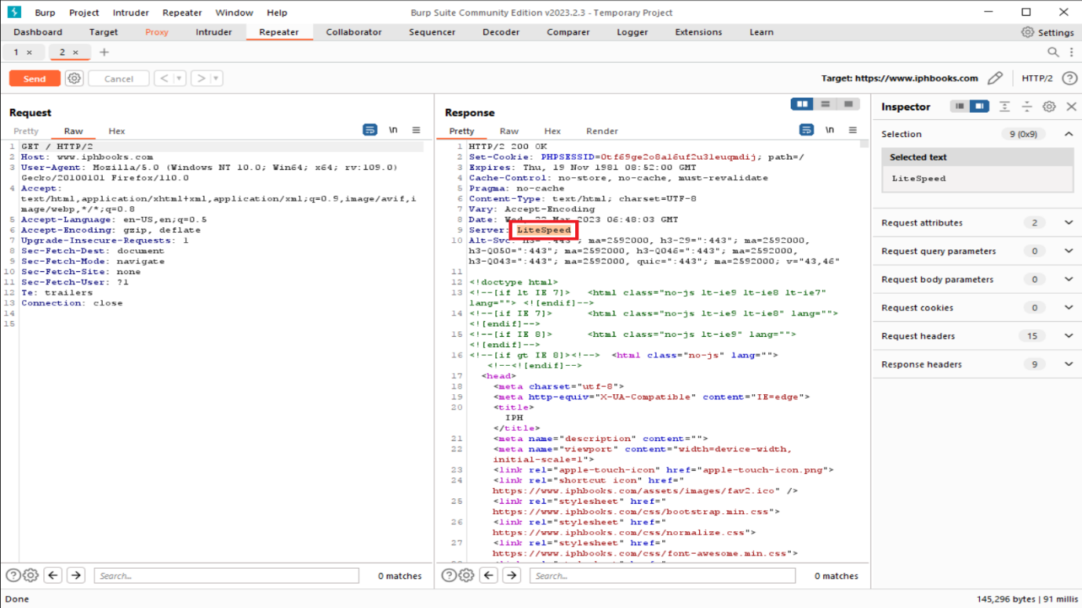
Step 3 :- Now in repeater click on send and then we can see the server version of the site.

Slide 26
Server Version Disclosure Prevention
Properly setting authentication cookies with Same Site Strict, unless they explicitly need None
Simply need to reconfigure the web server and, if necessary, restart it.
Resolve misconfigurations and uninstall high-risk software.

Slide 27

Target site
01
https://www.iphbooks.com/
IP Address :- 13.126.182.130
Vulnerability
02
Denial of Service Attack (DoS)
Severity
03
Low (https://bugcrowd.com/vulnerability-rating-taxonomy)
Impact
DoS attacks is to reduce the size of the available attack area.it is an attack meant to shut down or slow down a machine or network, making it inaccessible to its intended users. DoS attacks accomplish this by flooding the target with traffic.
04
Tools
05
Nmap ,hping3

Slide 28
Step 1 :- Visit this site

Slide 29
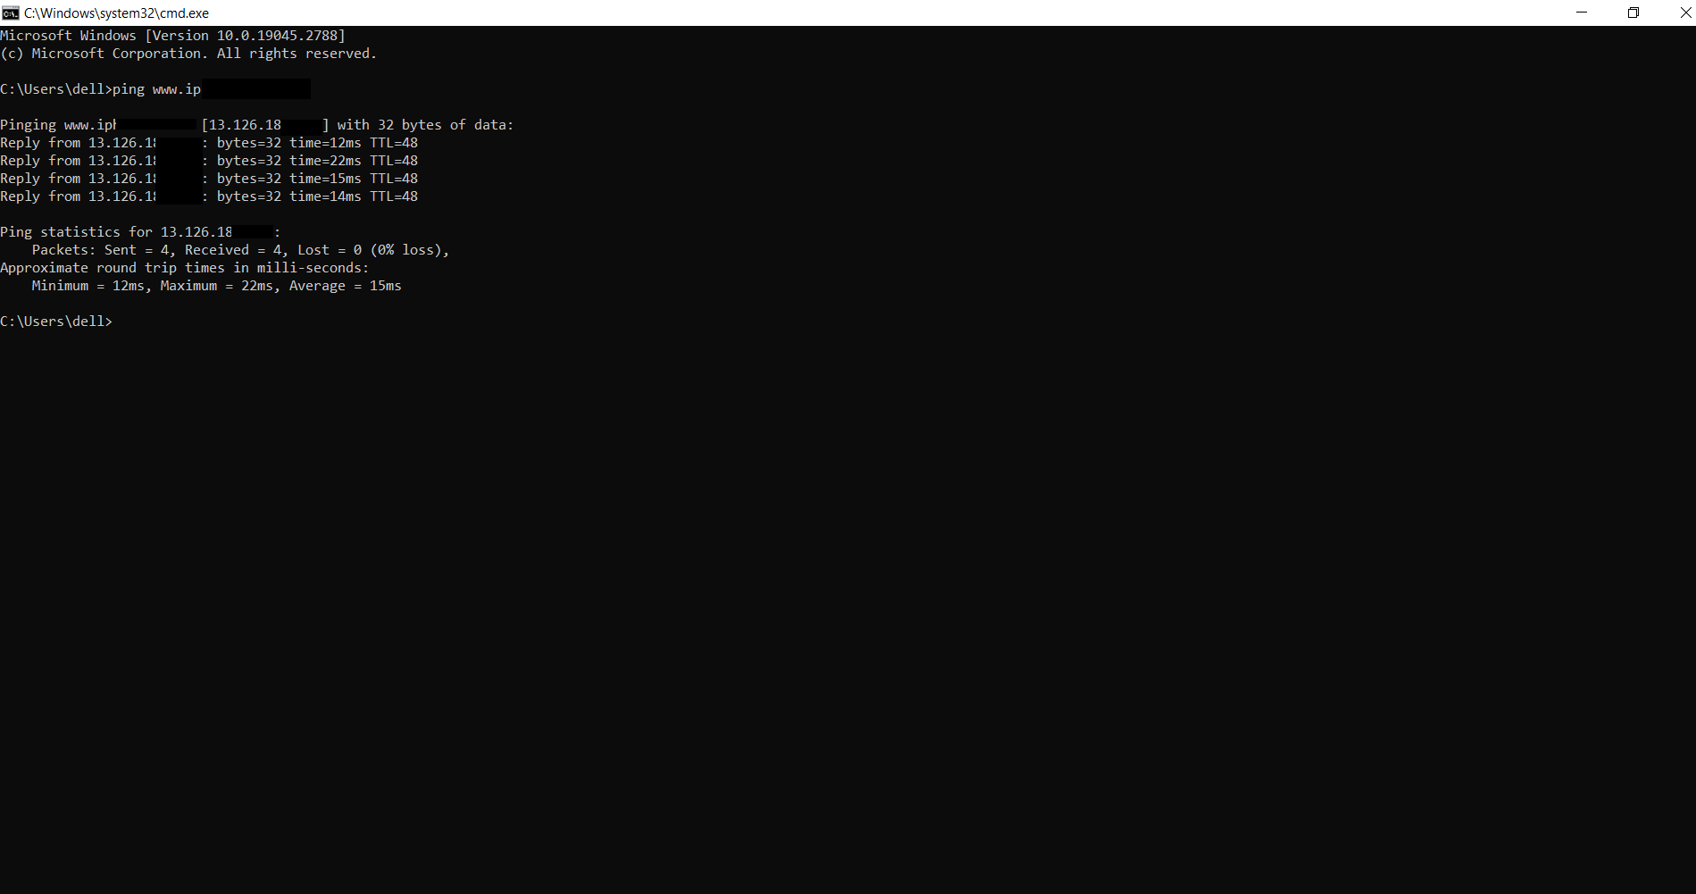
Step 2 :- Use ping command and we’ll get the IP Address.

Slide 30
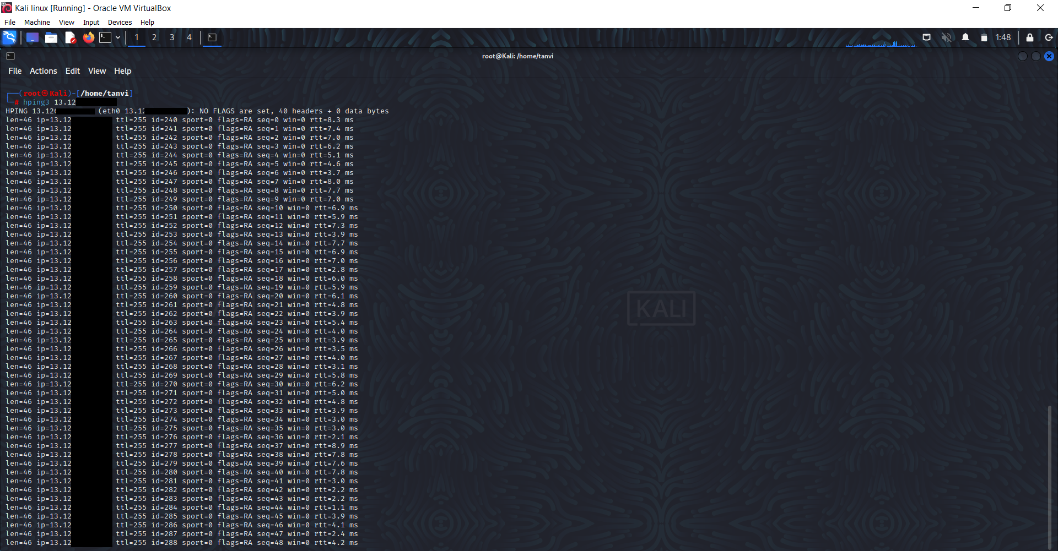
Step 3 :- Now use hping3 tool and enter the IP Address. Here it will transmit the packets and slow down the site.

Slide 31
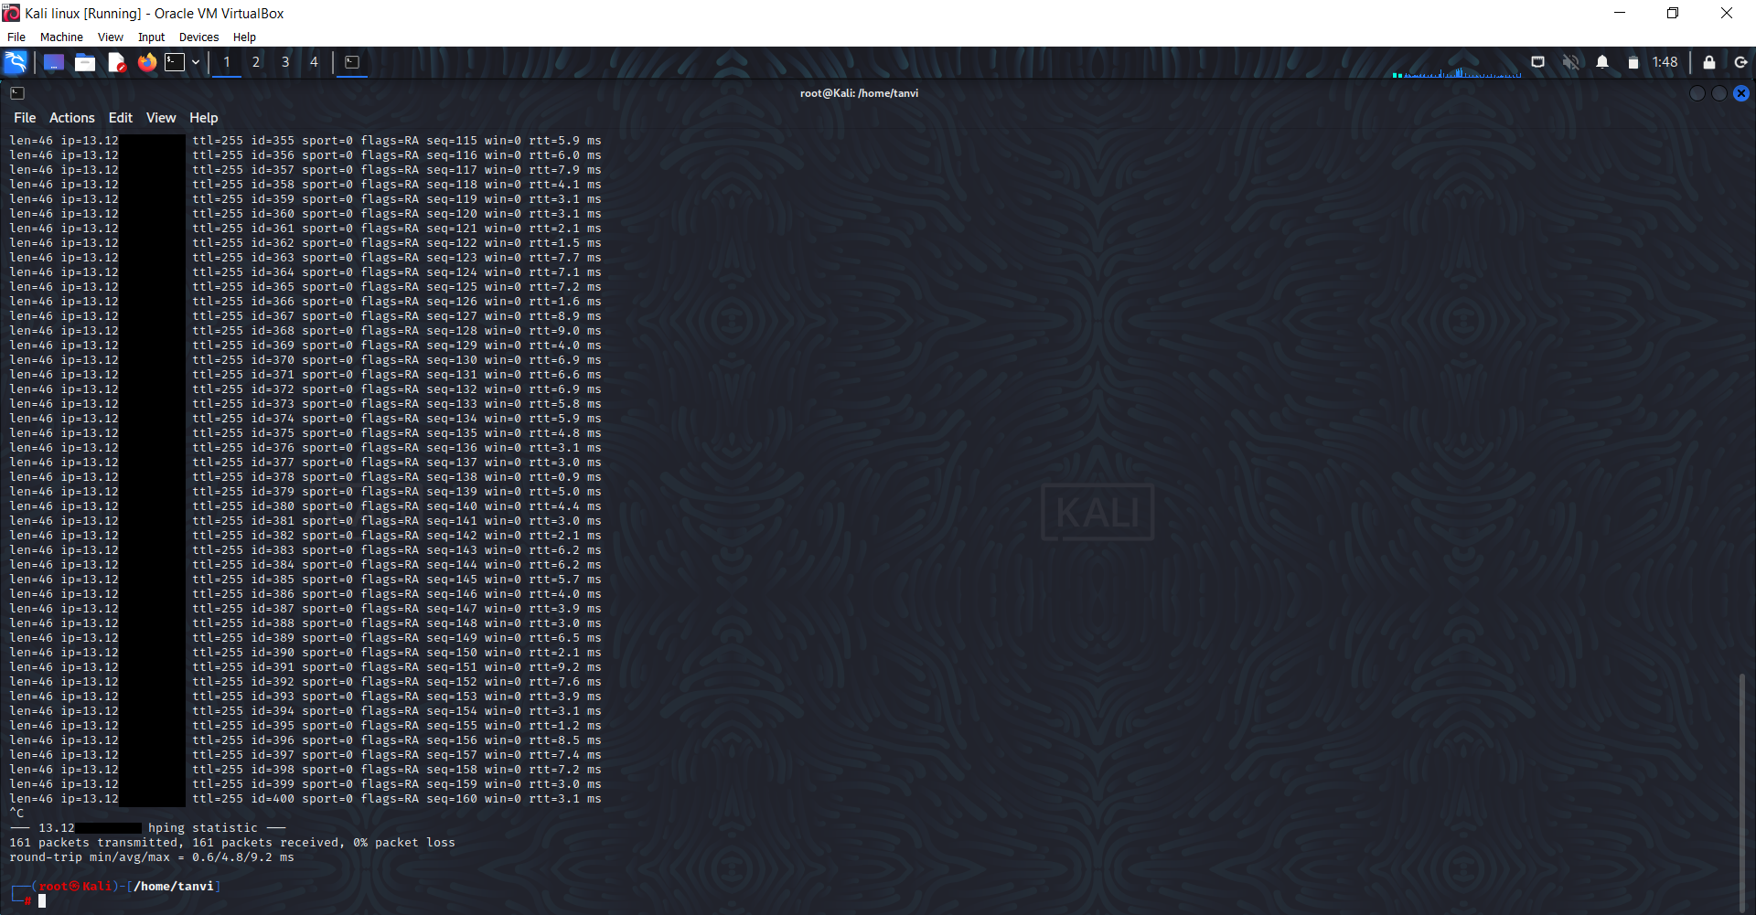

Slide 32
DOS Attack Preventions
Early detection and continuous traffic & packet profiling
Multi-layered DoS protection
Reduce attack surface exposure
Fortify the network architecture
Understand the Warning Signs

Slide 33
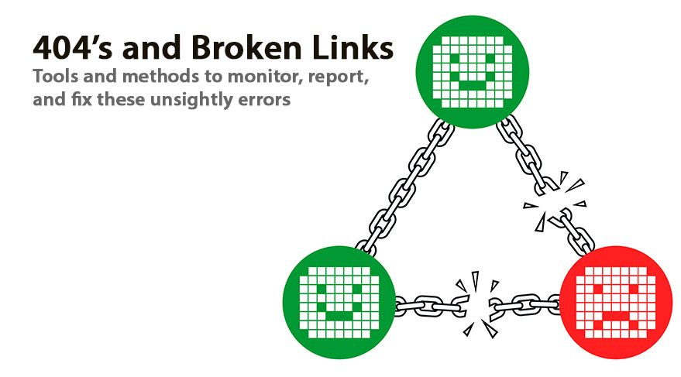
Target site
01
https://www.commonbond.co/
IP Address :- 13.115.182.240
Vulnerability
02
Broken Link Hijacking
Severity
03
Medium (https://bugcrowd.com/vulnerability-rating-taxonomy)
Impact
04
The attacker can create one phishing page and use it for different kinds of attack.
Tools
05
Nmap

Slide 34
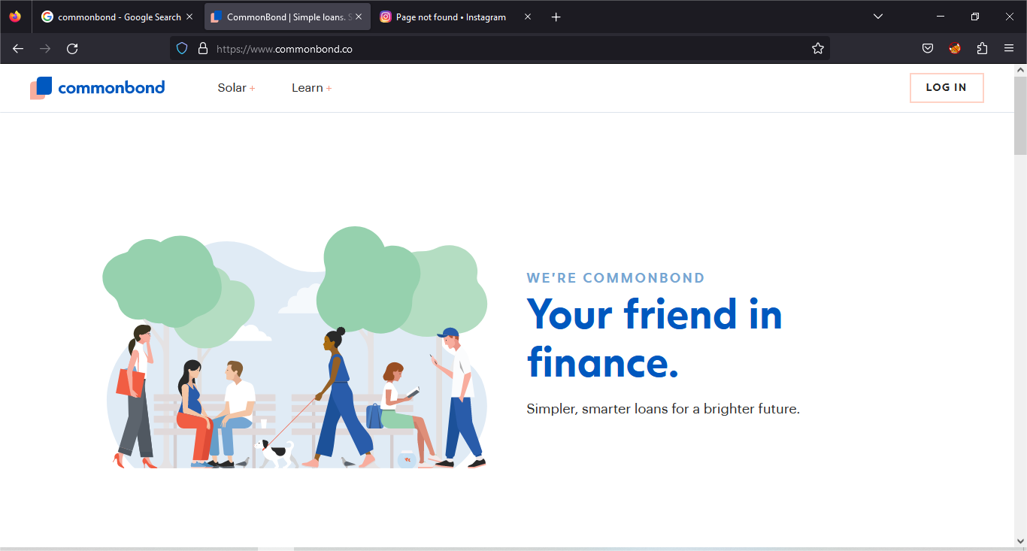
Step – 1: Visit this site.

Slide 35
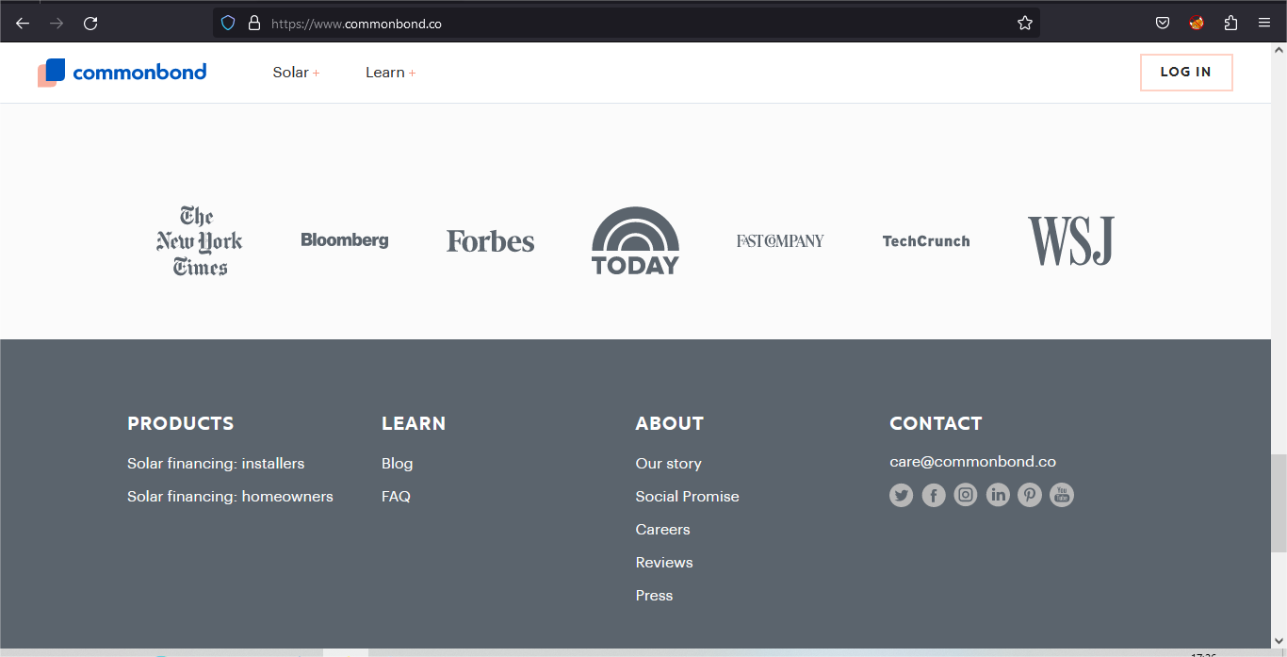
Step – 2: Go to the contact.

Slide 36
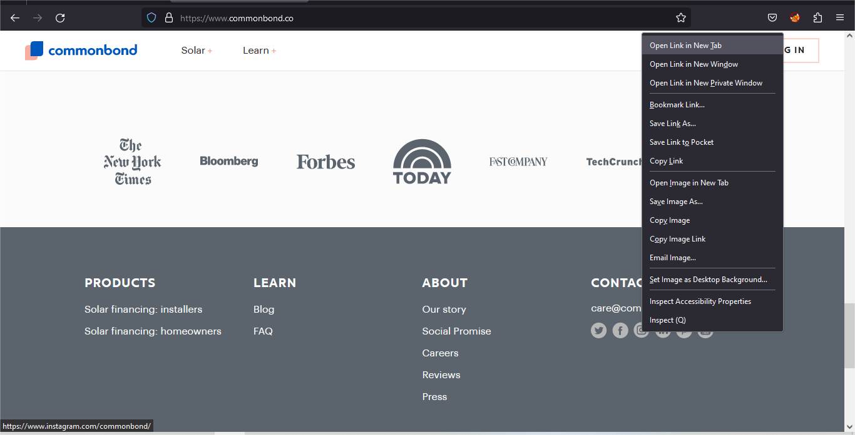
Step – 3: Right click on the Instagram icon and open link in new tab.

Slide 37

Step – 4: As a result, you can see this page is not found.

Slide 38
Broken Link Hijacking Prevention
The best way to prevent Broken Link Hijacking attacks is to proactively identify such stale/ dead links and remove them from the website regularly.
Regularly Scan for Vulnerabilities and Implement Sub Resource Integrity.

Slide 39

Target site
01
https://biramangolcollege.edu.in/
IP Address :- 103.154.184.133
Vulnerability
02
File Upload
Severity
03
Medium (https://bugcrowd.com/vulnerability-rating-taxonomy)
Impact
Being easy to execute and potentially exploited for various malicious activities, a file upload vulnerability is a common target of hackers. Using this file upload vulnerability attacker can perform the Phishing attacks, Remote code execution etc.
04
Tools
05
Nmap

Slide 40
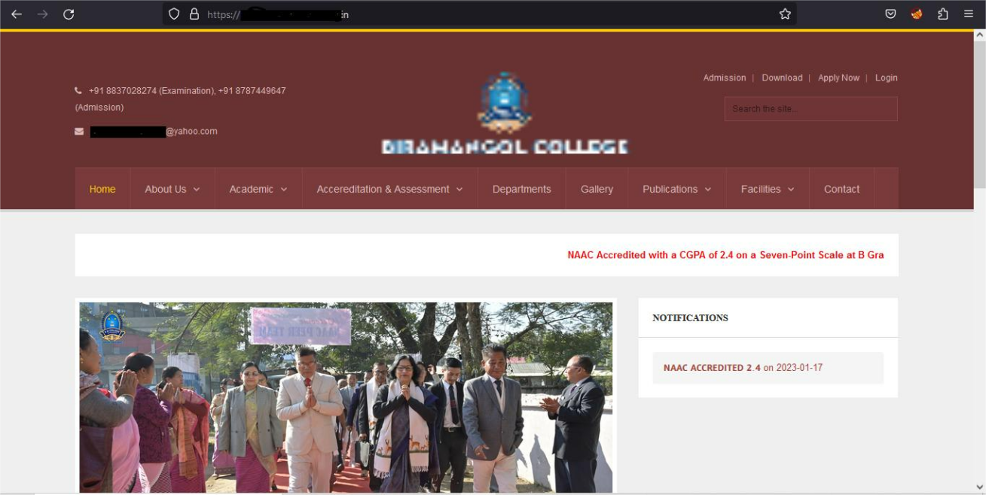
Step 1 :- Visit this site

Slide 41
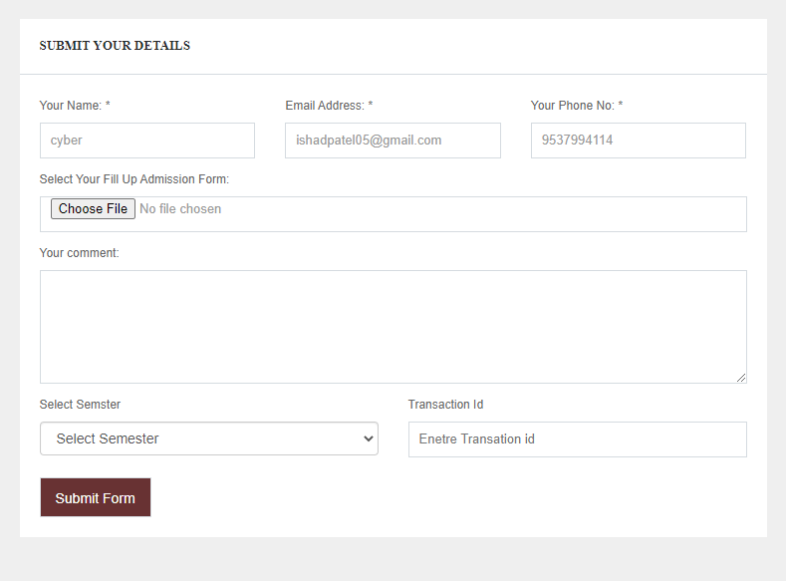
Step 2 :- And go to the Registration page.

Slide 42
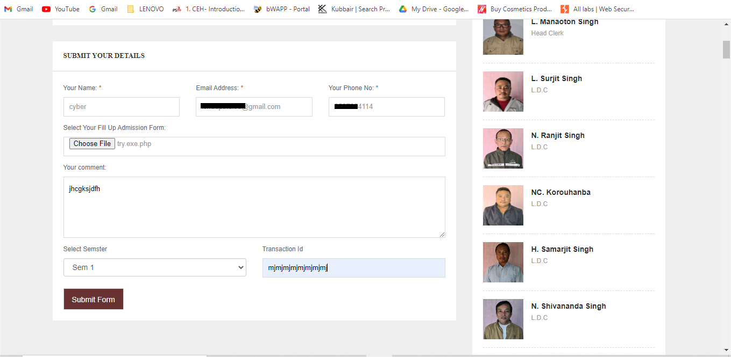
Step 3 :- Fill up all the details like name, email, phone no, comment, semester, transaction id. After click the choose file and select the php file.

Slide 43
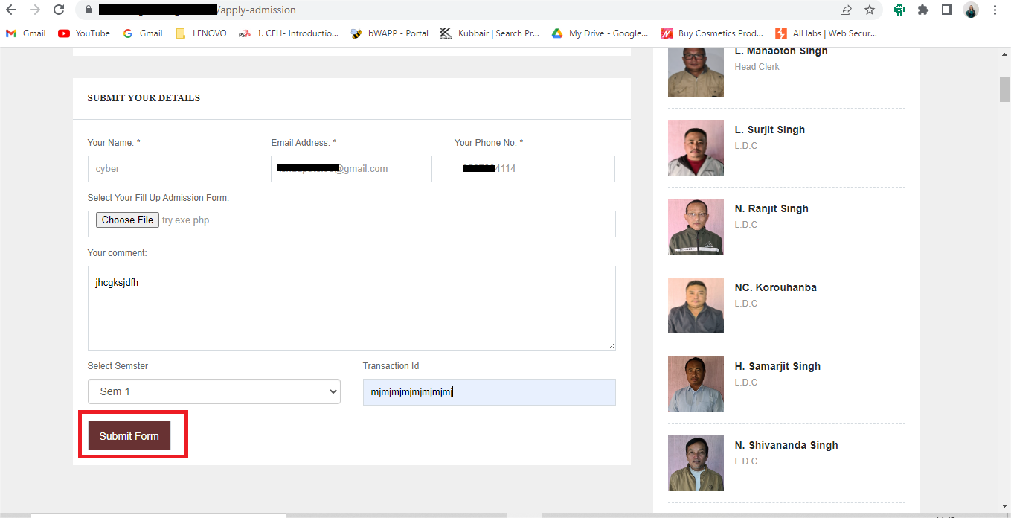
Step 4 :- In this php file we can write a malicious script and after submit form this php file store on the server. It is a very harmful.
Step 5 :- we can select file after click the submit form button and this form successfully register.

Slide 44
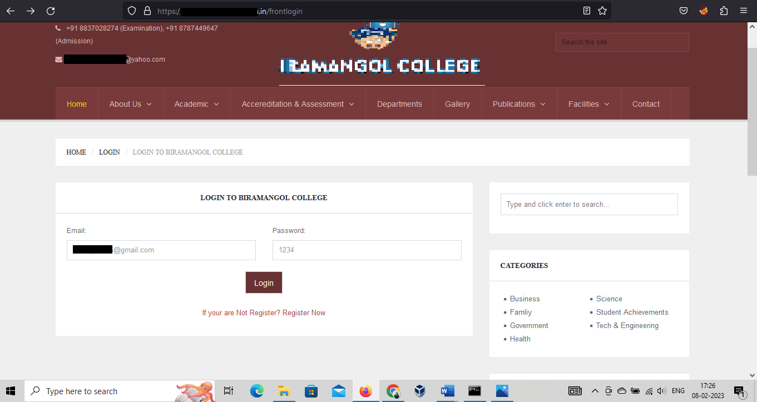
Step 6 :- As a result, using email address and password we can login successfully.

Slide 45
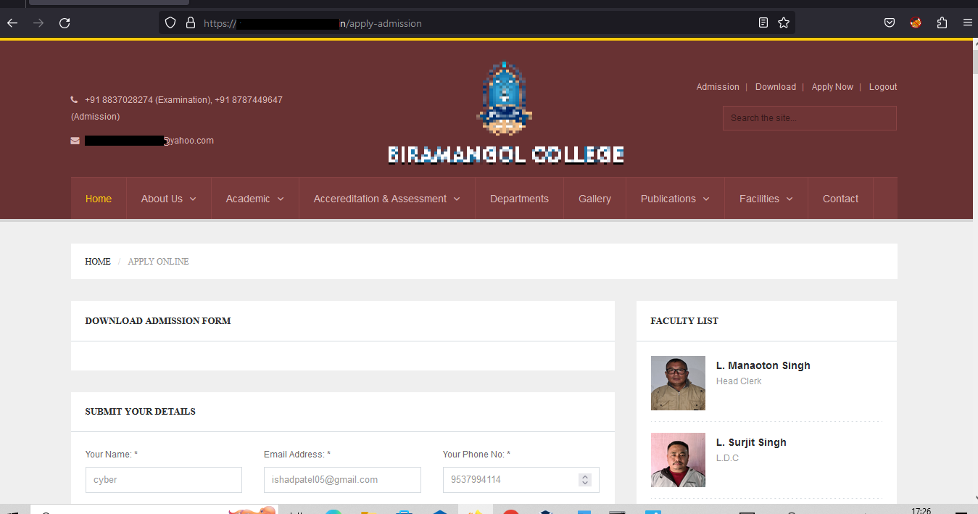

Slide 46
File Upload Prevention
Only allow specific file types
Verify file types.
File size restrictions.

Slide 47
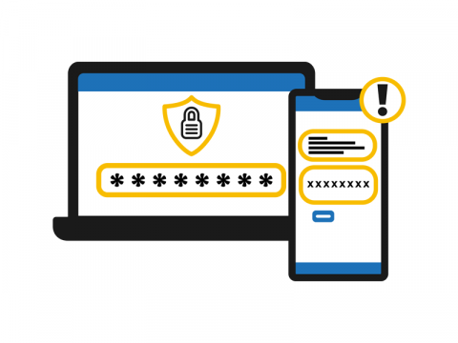
Target site
01
https://www.makemytrip.com/
IP Address :- 15.197.238.104
Vulnerability
02
OTP Brute Force
Severity
03
Medium (https://bugcrowd.com/vulnerability-rating-taxonomy)
Impact
04
Stealing someone's identity to access their accounts, such as bank accounts or credit cards. This enables the attacker to purchase goods using these details
Tools
05
Nmap ,Burp Suite

Slide 48
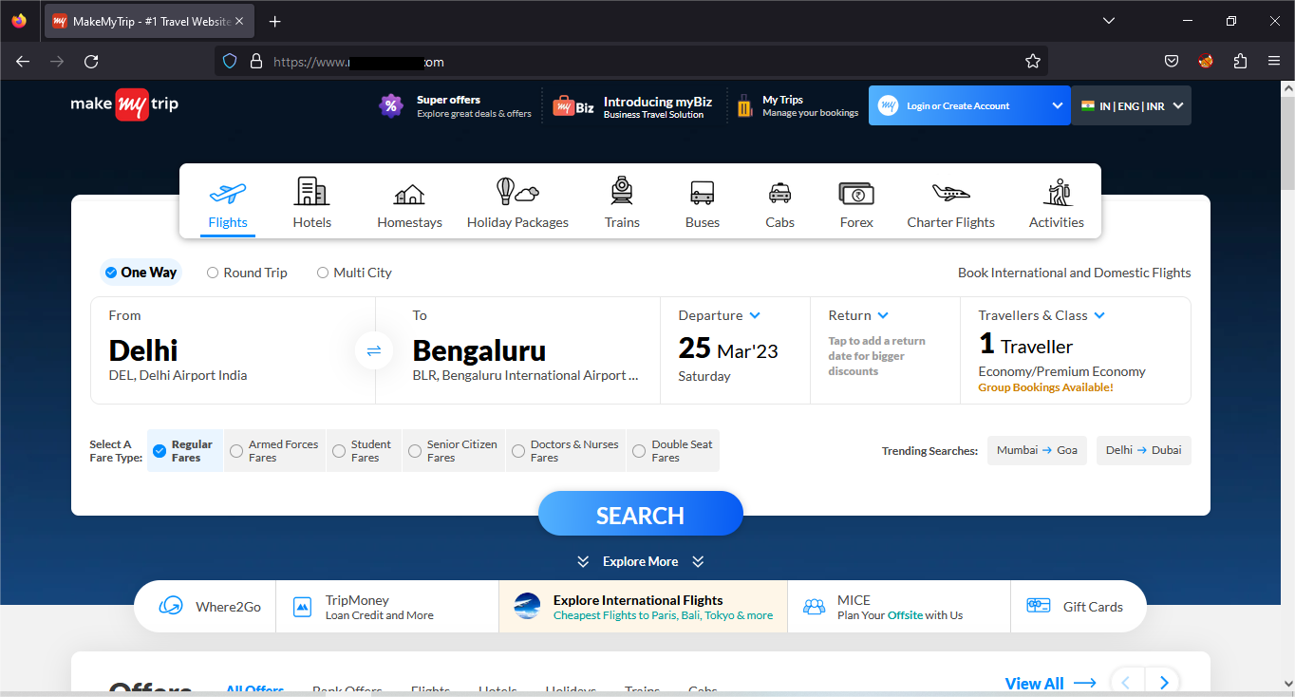
Step 1 :- Visit this site

Slide 49
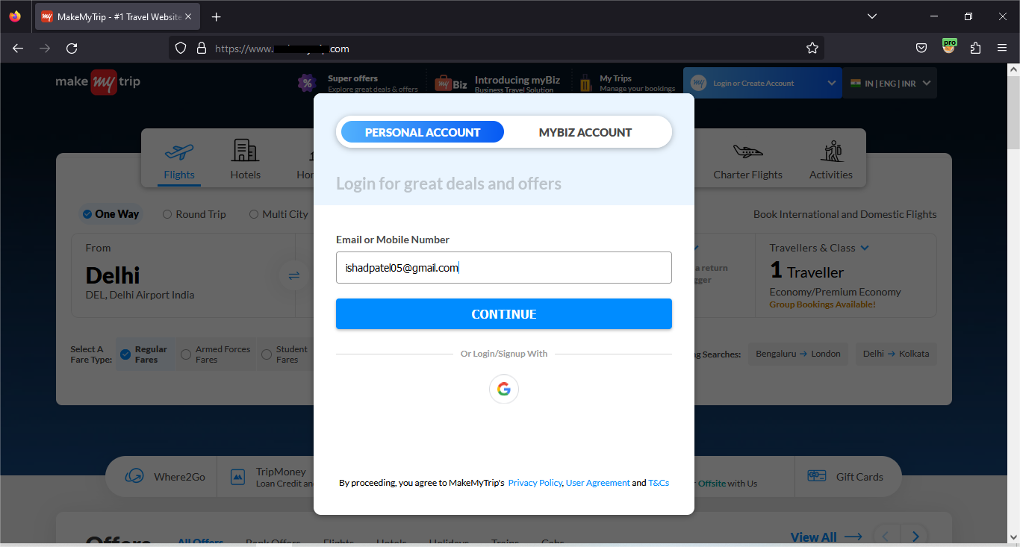
Step 2 :– Go to the login page and enter the email id and then click the Continue button.

Slide 50
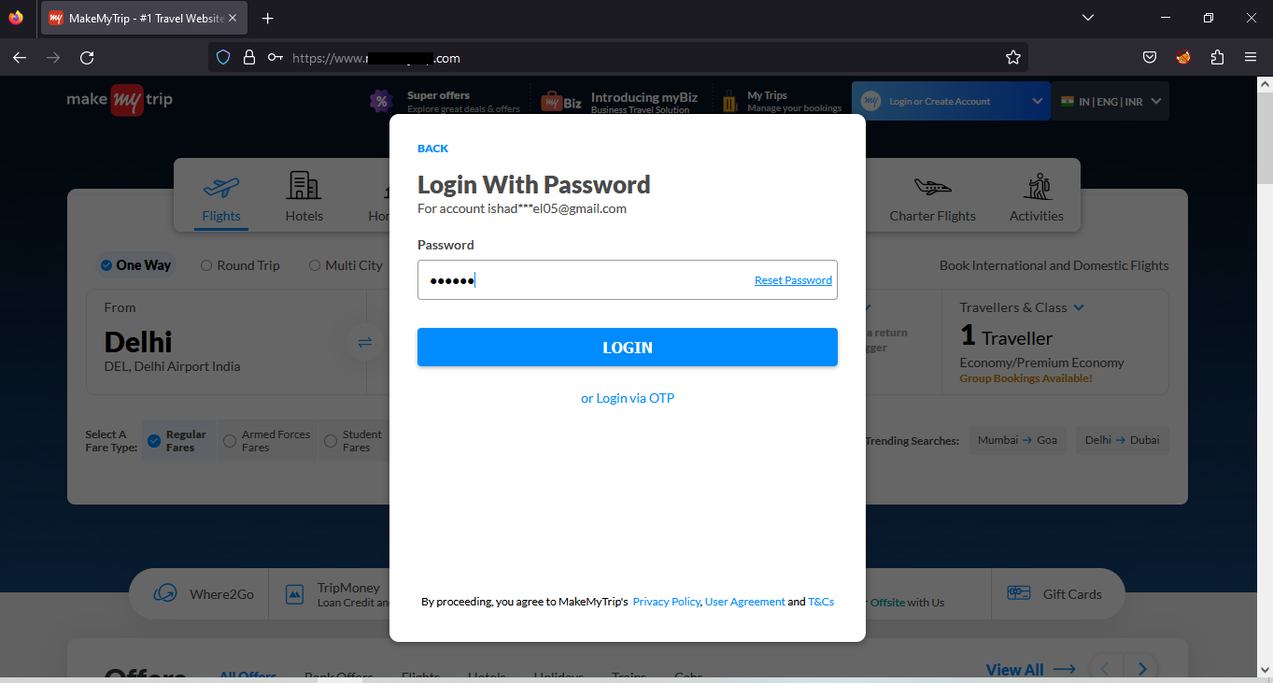
Step 3 :- Enter the email id after we can enter the any wrong OTP and click the Login button.

Slide 51
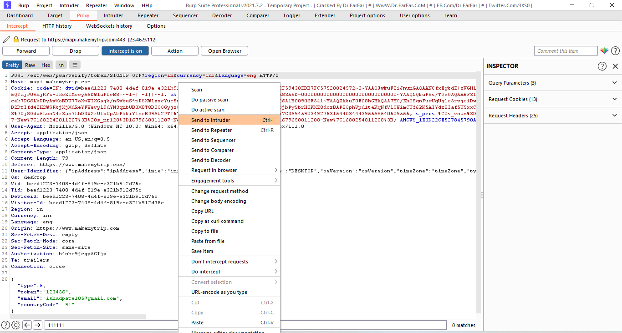
Step 4 :- After we can capture the request in burp suite and send the Intruder.

Slide 52
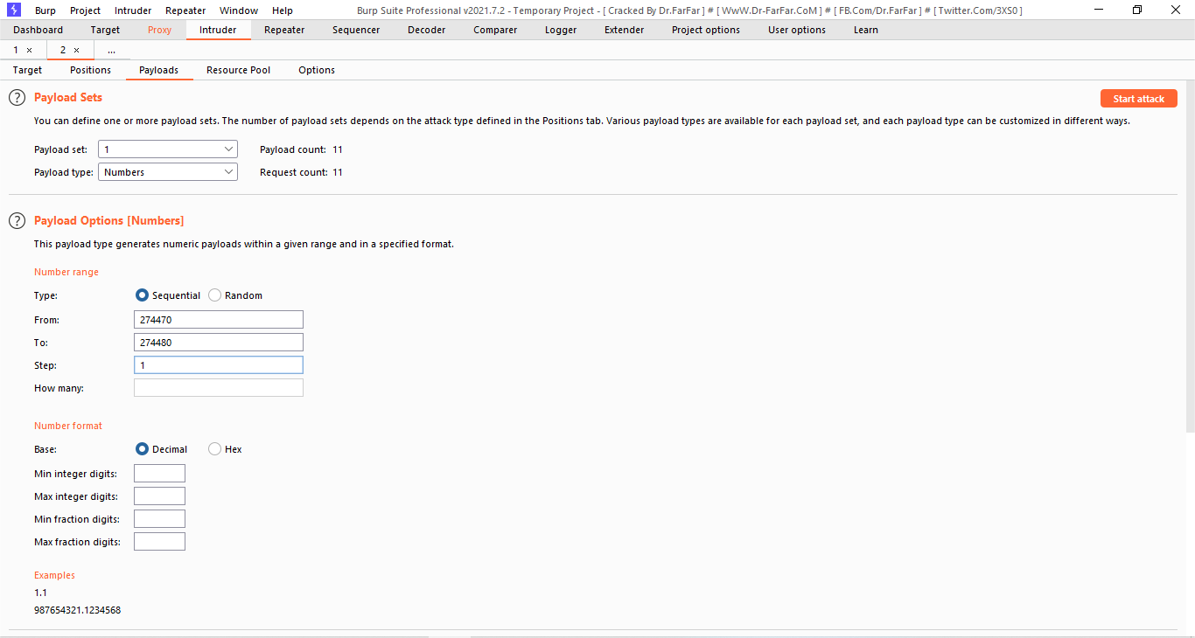
Step 5 :- In this Intruder we can set the payload for the brute force and click on the start attack button. After the attack is a start.

Slide 53
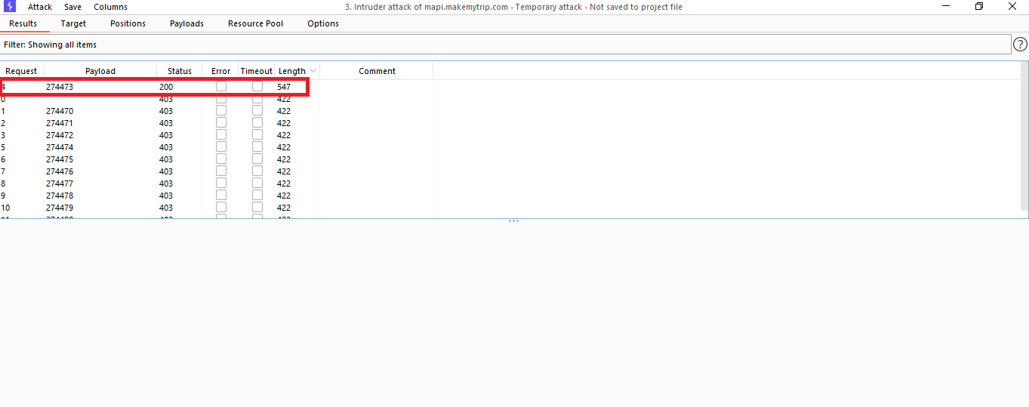
Step 6 :- After we get the minimum length number. It is our right OTP.

Slide 54
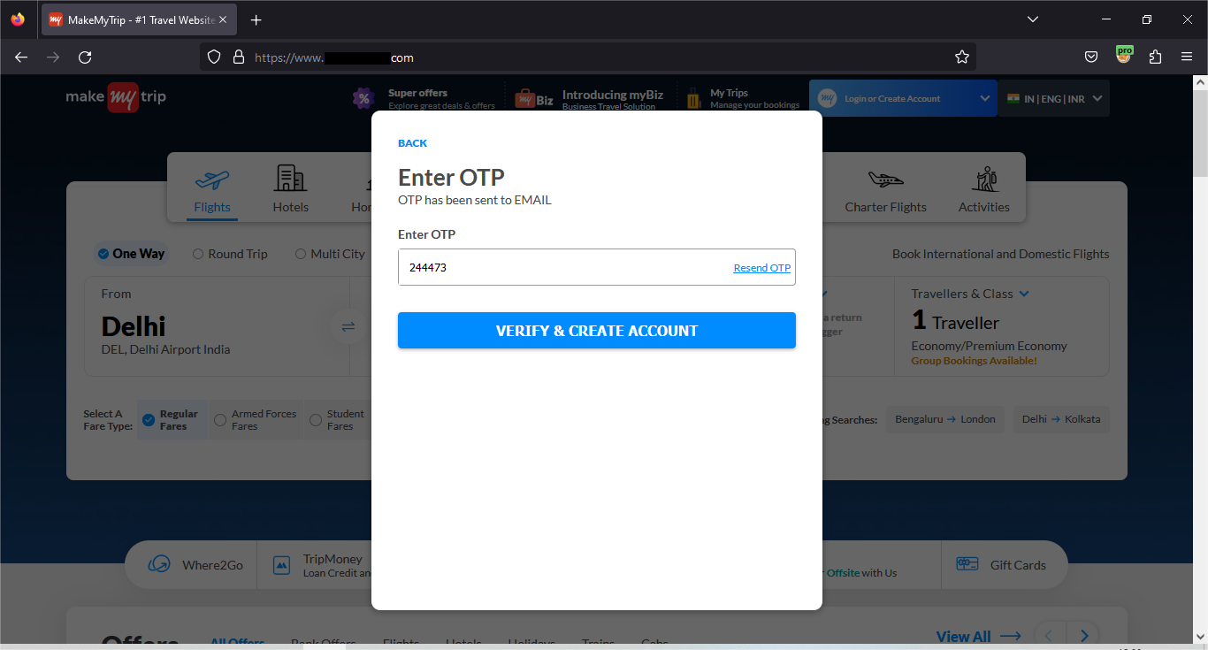
Step 7 :- Enter this right OTP and click on the VERIFY button.

Slide 55
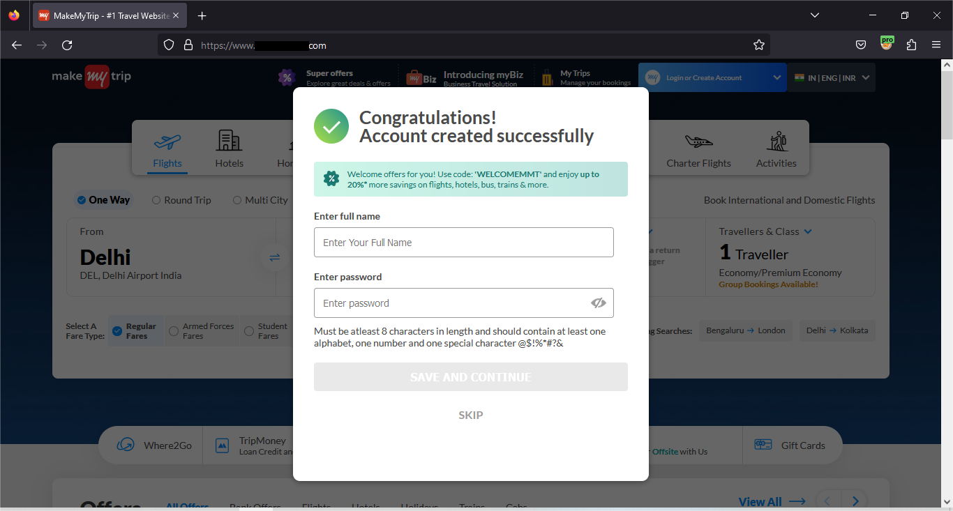
Step 8:-As a result, We can login successful.

Slide 56
OTP Brute Force Prevention
Use CAPTCHA
Use strong password
Limit Logins to a Specified IP Address
Use 2-Factor Authentication
Account Lockouts After Failed Attempt
Monitor Your Server Logs

Slide 57

Target site
01
https://www.makemytrip.com/
IP Address :- 15.197.238.104
Vulnerability
02
Authentication Bypass
Severity
03
High (https://bugcrowd.com/vulnerability-rating-taxonomy)
Impact
04
There is always a risk that the user’s privacy will be compromised as those who bypass SMS will have access to OTP.
Tools
05
Nmap ,Burp Suite

Slide 58
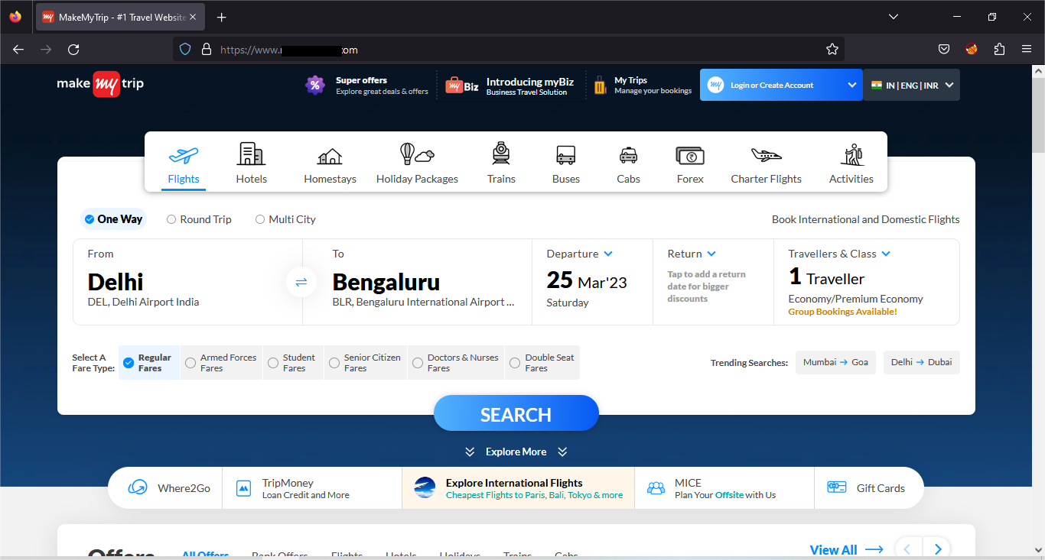
Step – 1: Visit this site -

Slide 59
Step – 2: Go to the login page and enter the email id and then click the Continue button.

Slide 60
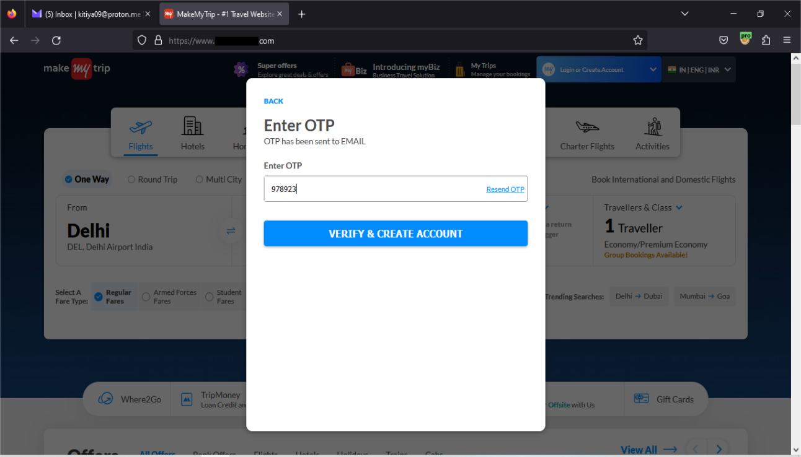
Step – 3: Enter the email id after we can enter the any right OTP and click the VERIFY button.

Slide 61
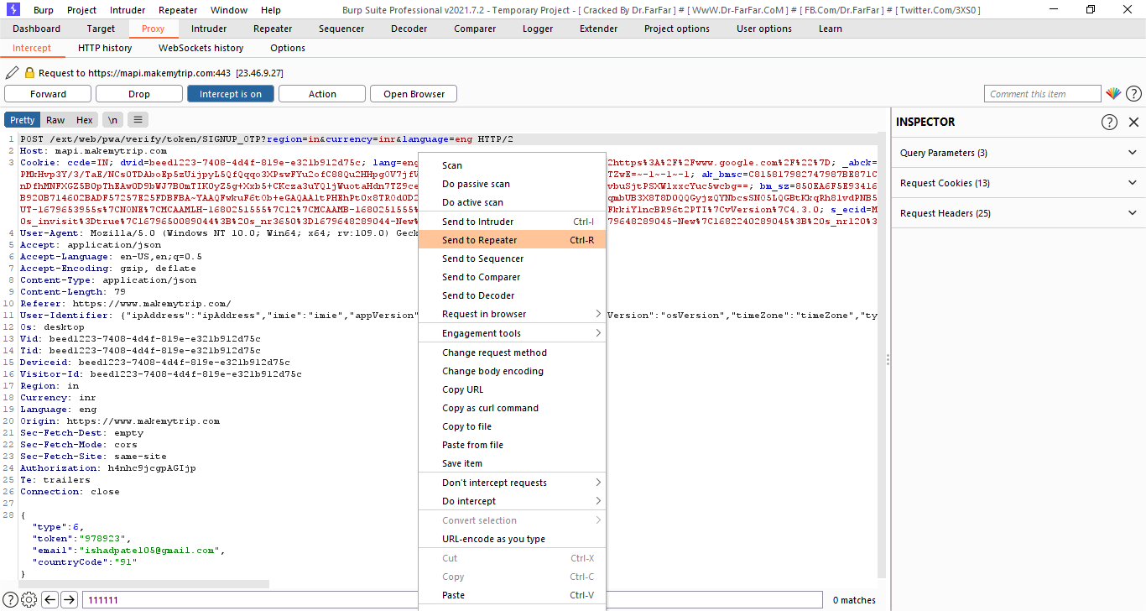
Step – 4: After this request capture in the burp suite and send to the repeater.

Slide 62
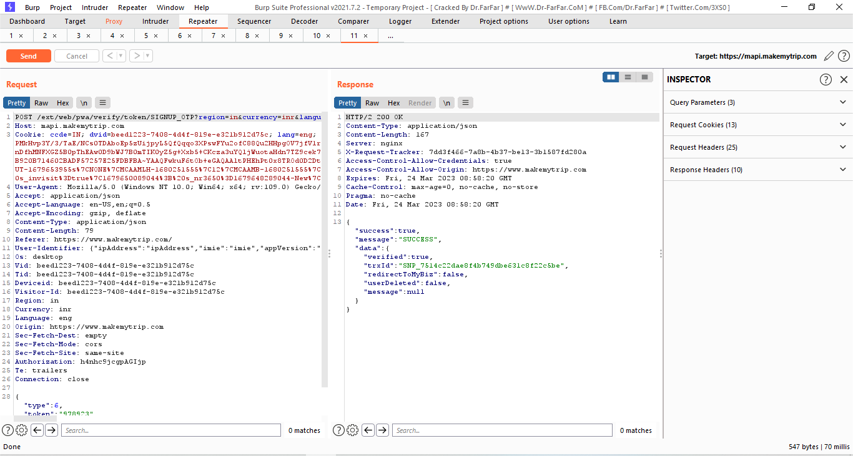
Step – 5: In this repeater we can see the request and right OTP response.

Slide 63
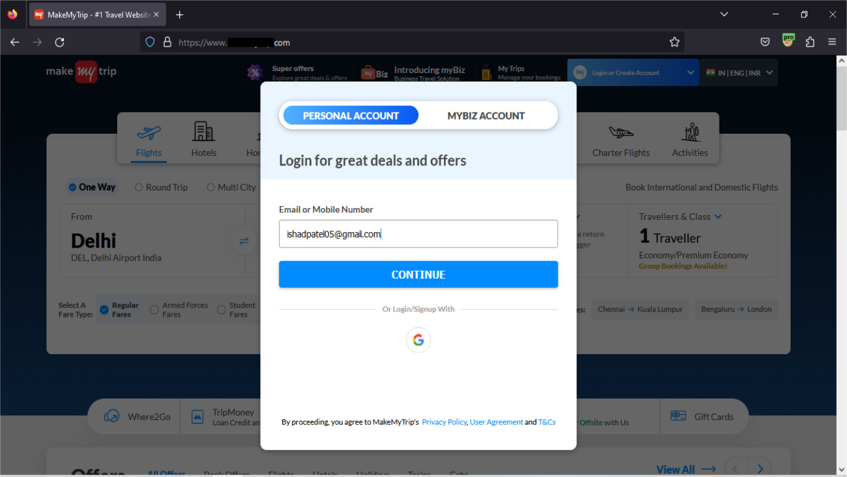
Step – 6: After go to the browser and enter the Same email address.

Slide 64
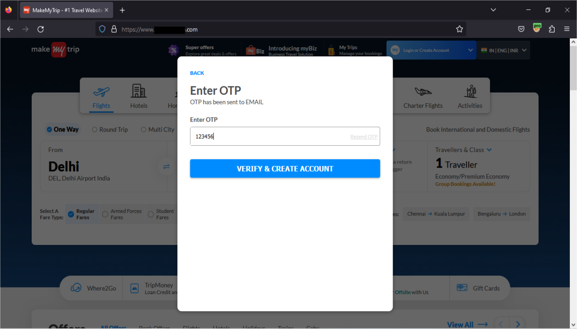
Step – 7: After we can enter the any wrong OTP and click the VERIFY button.

Slide 65
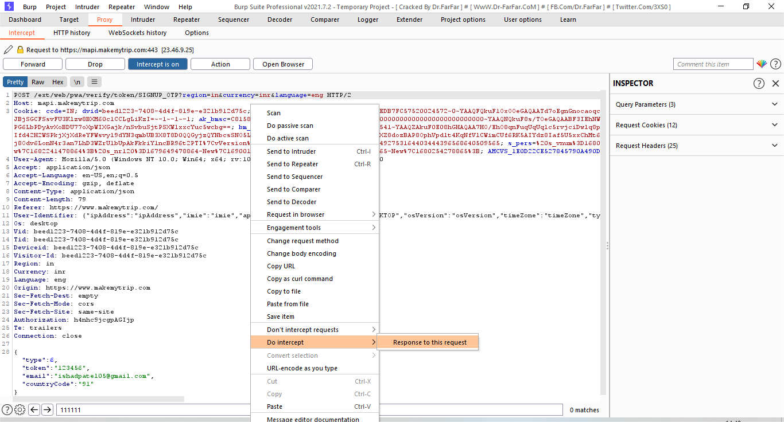
Step – 8: And this request capture in the burp suite and right click and select the Do intercept and select the Response to this request.

Slide 66
Step – 9: After click the Forword and we get this request. We can modify this request.

Slide 67
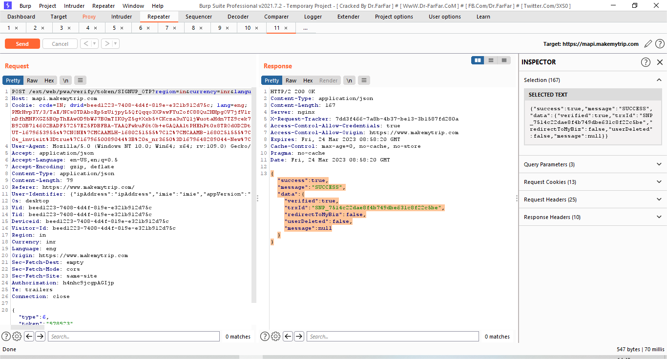
Step – 10: After go to the repeater tab and copy this code.

Slide 68
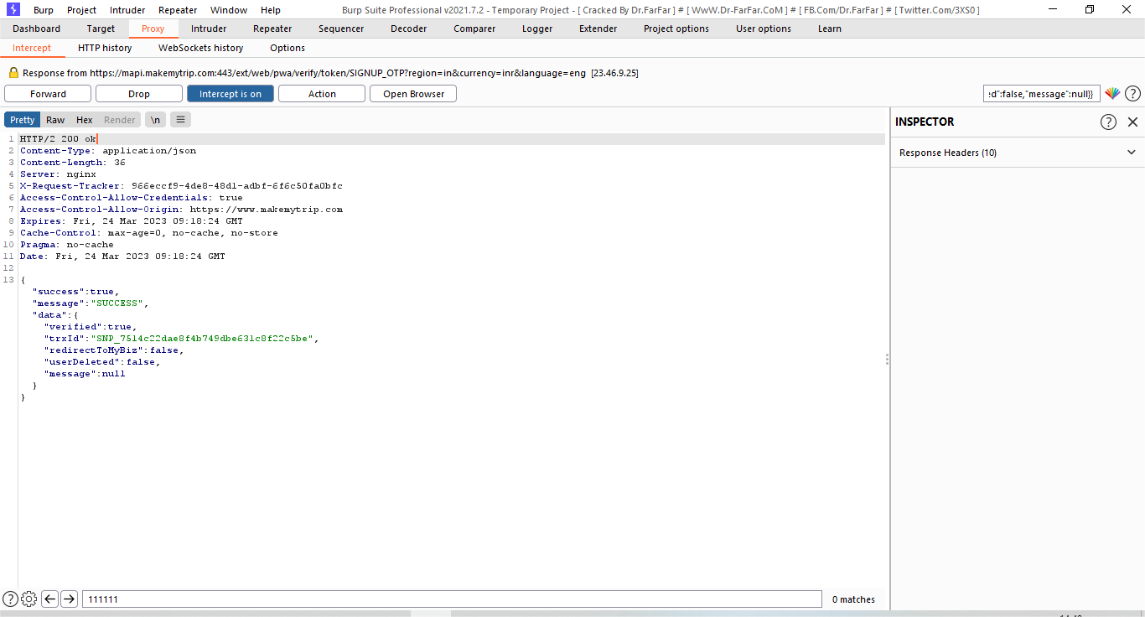
Step – 11: After paste the code and the 403 Forbidden replace the 200 ok. After click the Forword.

Slide 69
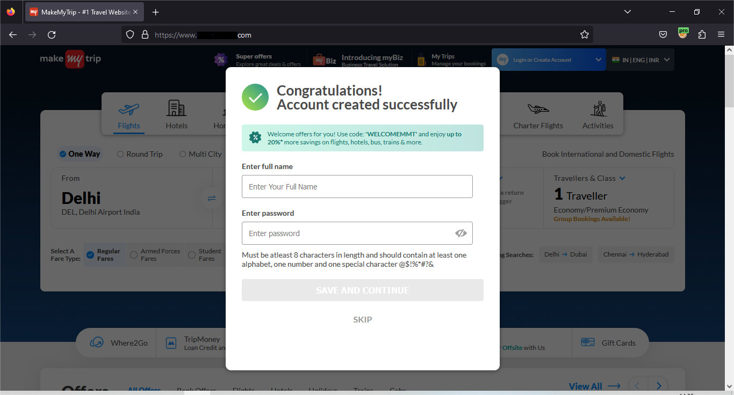
Step – 12: As a result, this account created successfully.

Slide 70
Authentication Bypass Prevention
Keep your systems, software, applications, networks, and operating systems up-to-date to protect from authentication bypass vulnerability.
Ensure that all your systems, applications, and folders are password protected.
Organizations should have a robust and secure authentication policy in place.
It is recommended to install a good antivirus program.
Do not use external SQL interpreters.

Slide 71
Target site
01
https://cheatsheetseries.owasp.org/cheatsheets/
IP Address :- 13.126.182.130
Vulnerability
02
OTP Bypass On Register Page
Severity
03
Medium
Impact
04
By exploiting this vulnerability an attackers can bypass OTP verification on Grab android app on any mobile number using "Login with mobile number" option. Attacker can succeed in the account takeover of any user without any privileges, using only phone number and country code.
Tools
05
Nmap

Slide 72
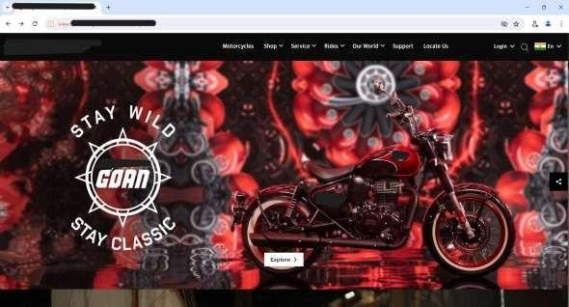
Step 1: - I visit the website and navigate to the login screen.

Slide 73
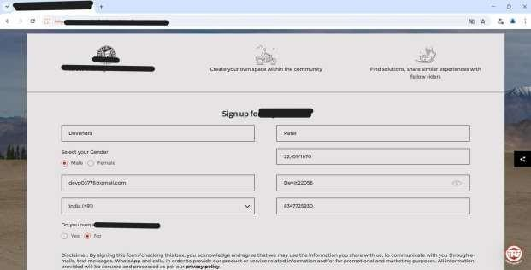
Step 2. And then create account and fill up the form

Slide 74
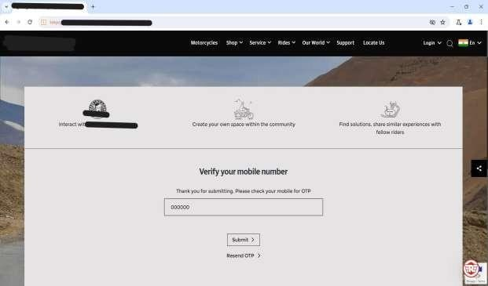
Step 3:- After verify your mobile number and enter random six-digit OTP, click on the submit button.

Slide 75

Target site
01
https://www.iphbooks.com/
IP Address :- 13.126.182.130
Vulnerability
02
SQL Injection
Severity
03
Critical (https://bugcrowd.com/vulnerability-rating-taxonomy)
Impact
04
The attacker can hijack user accounts and steal the sensitive data. An attacker can also steal cookies and sessions.
Tools
05
Nmap , Sqlmap

Slide 76

Step 1:- Visit :- https://www.iphbooks.com/

Slide 77
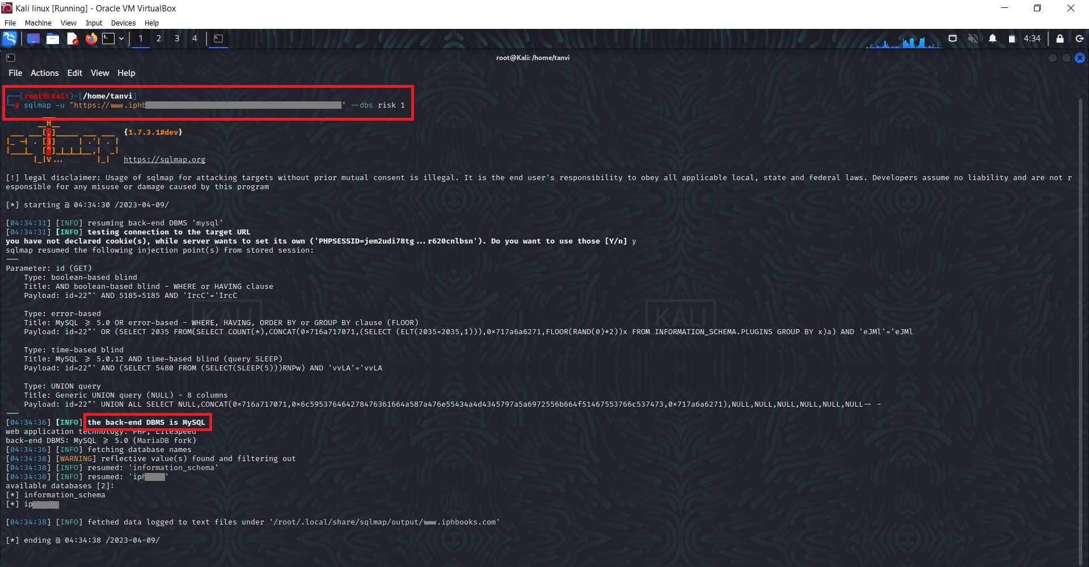
Step 2:- Use SQL map tool in kali Linux. put -u before the URL Nd then provide the URL. Use --dbs for getting the database control and use –risk 1 for increasing the risk level then we get the information that the backend database is MySQL.

Slide 78
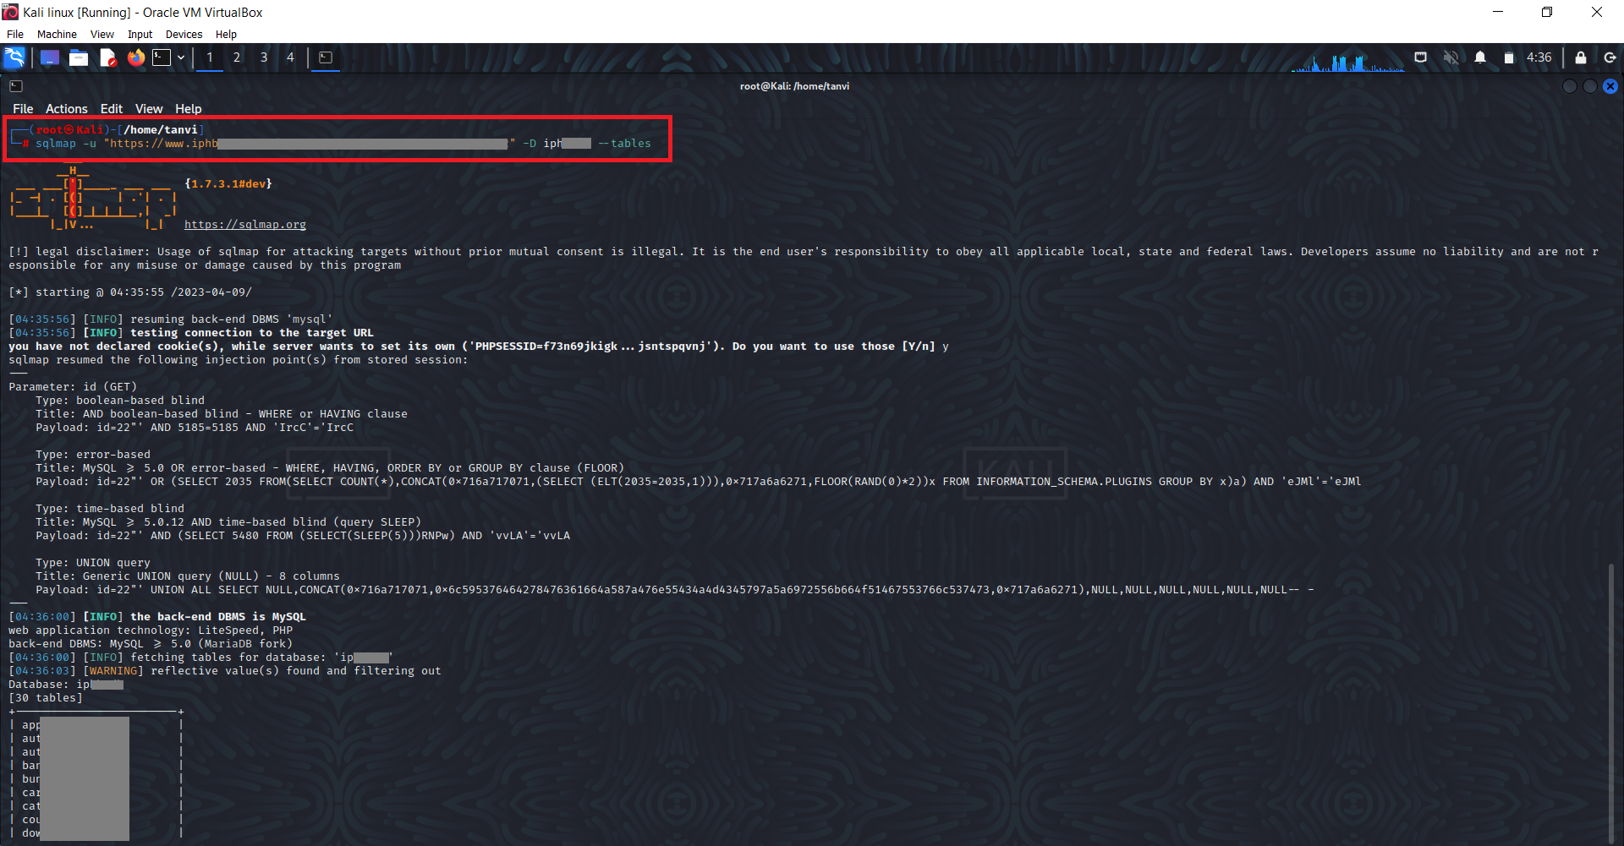
Step 3:- After getting the database name use --tables command for retrieve all the tables name.

Slide 79
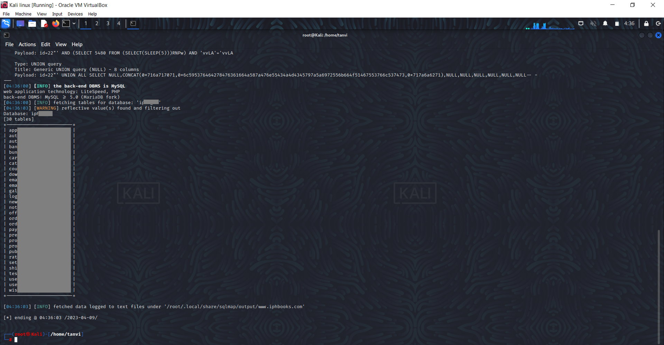
Step 4 :- Here we are able to retrieve all the tables name and also access the table data of database.

Slide 80
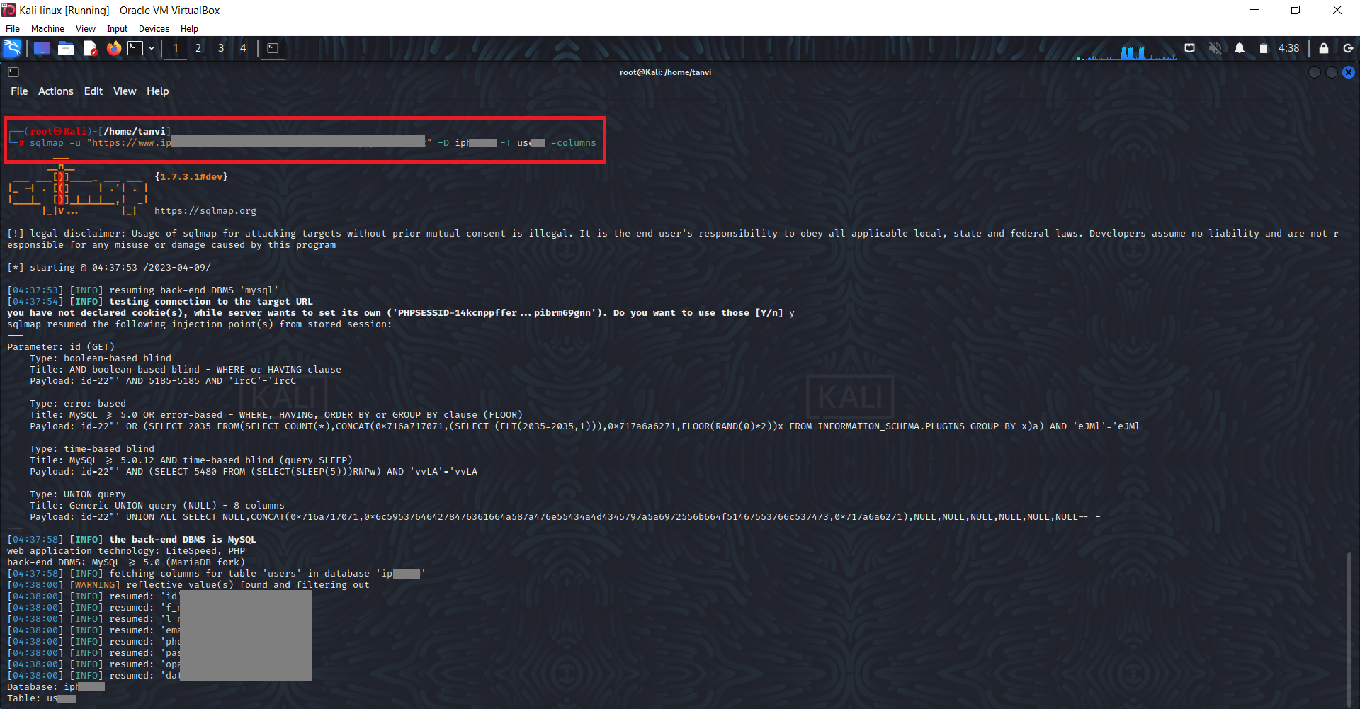
Step 5:- After getting the tables we have to find columns in that tables for that use -D database name -T table name –columns.

Slide 81
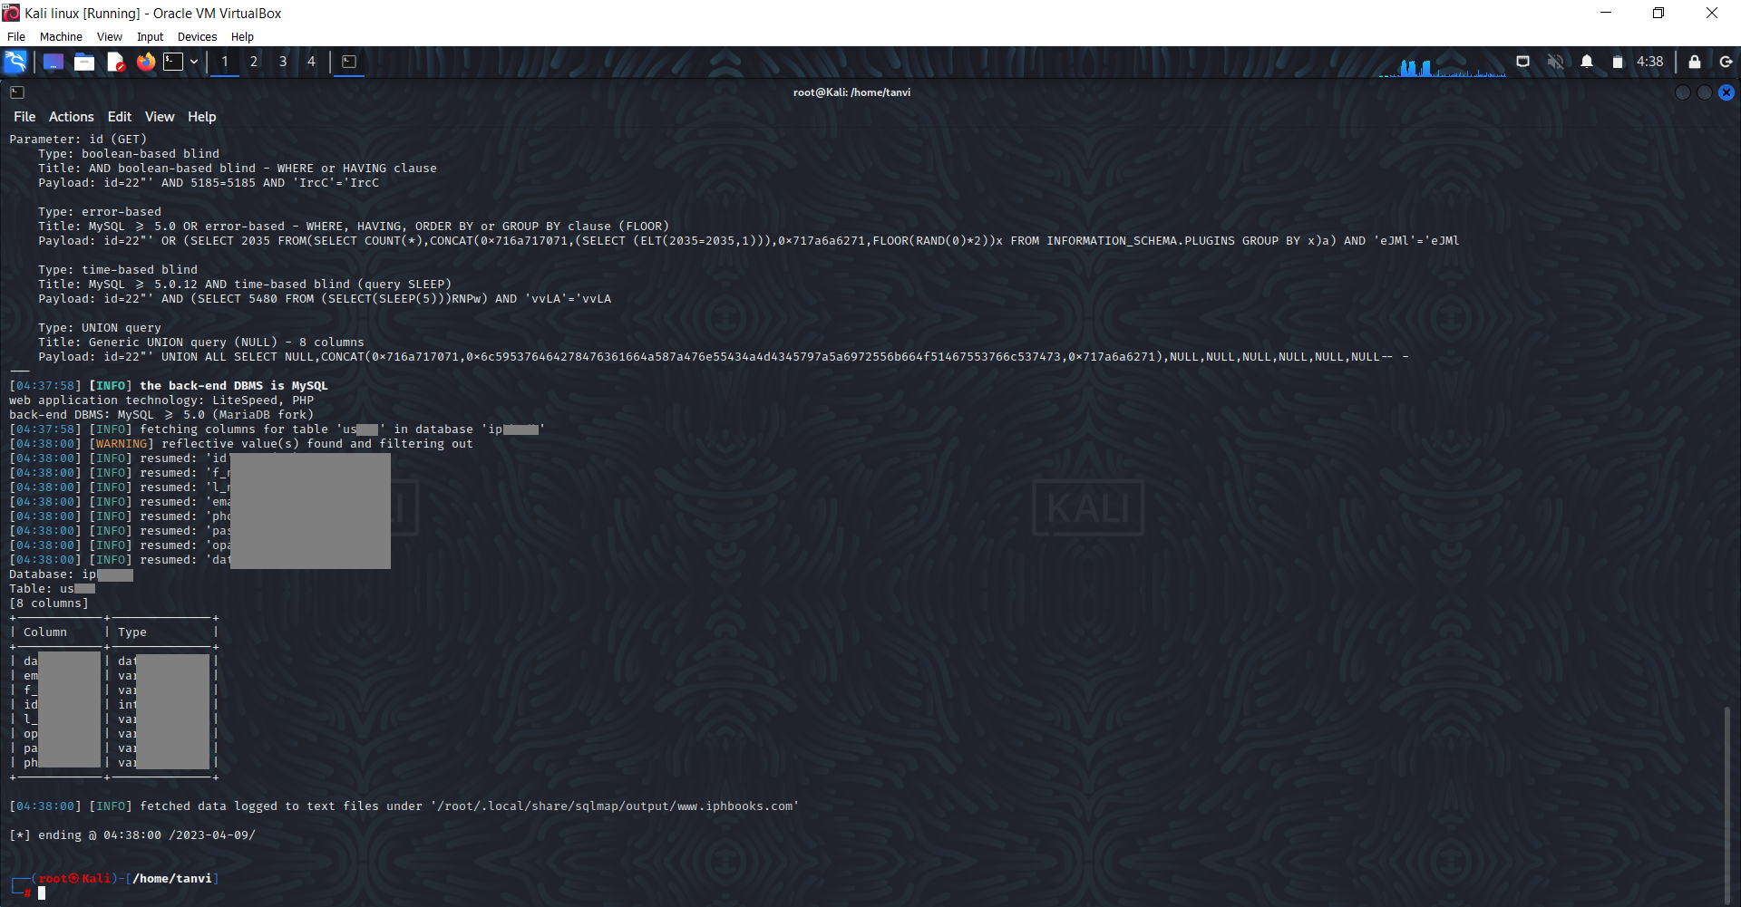
Step 6:- Here the columns in that table will be retrieved.

Slide 82
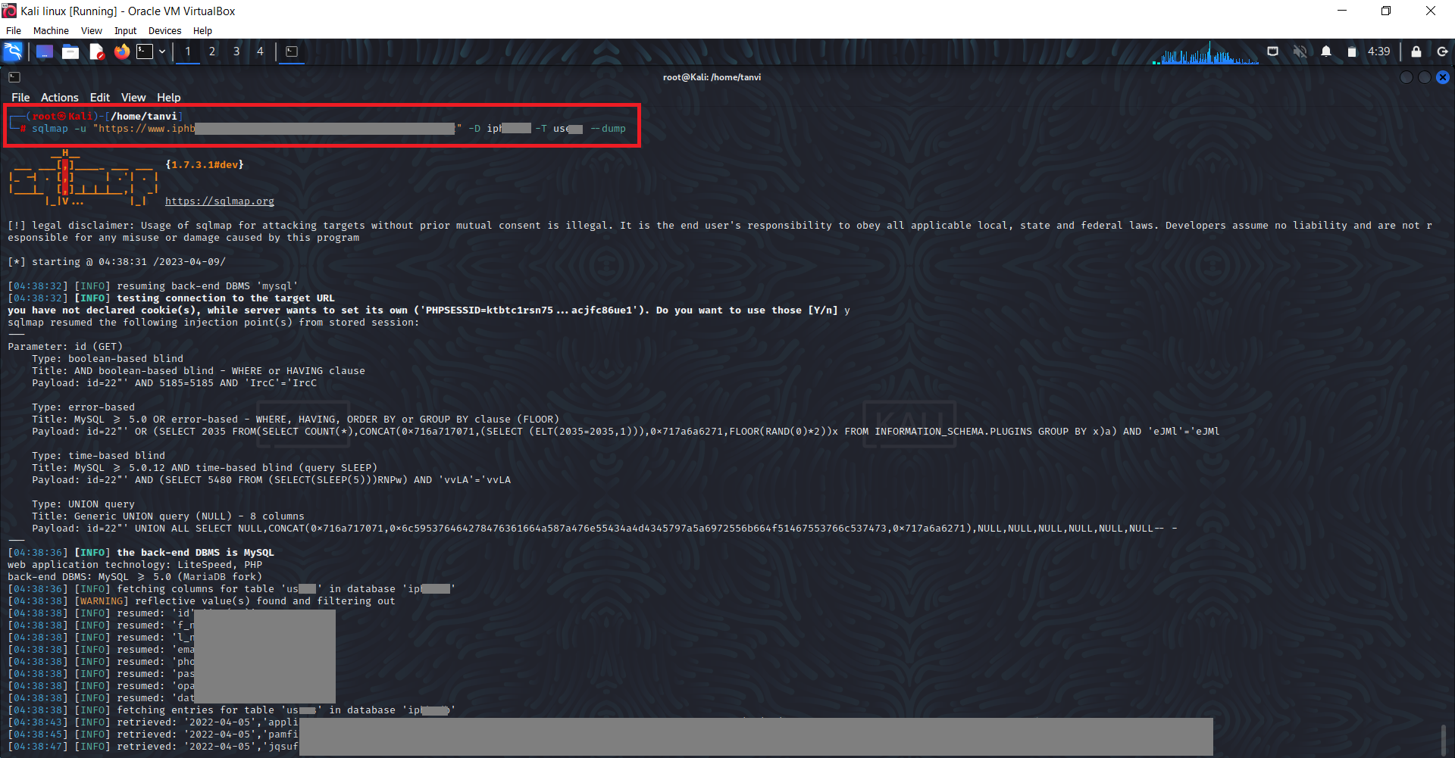
Step 7:- After getting the column of that table use --dump for retrieve the data of that table.

Slide 83
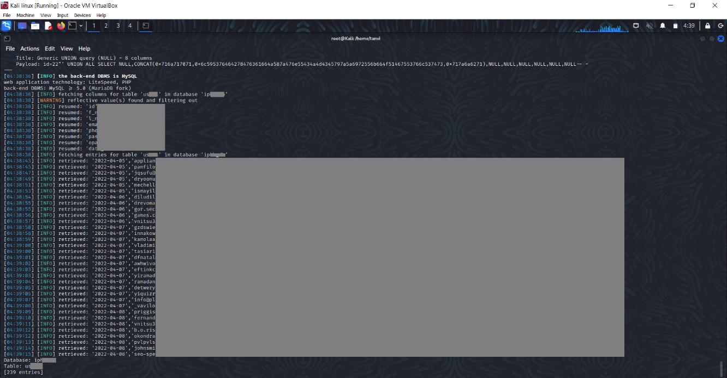
Step 8:- As a result, we found the data of those table.

Slide 84
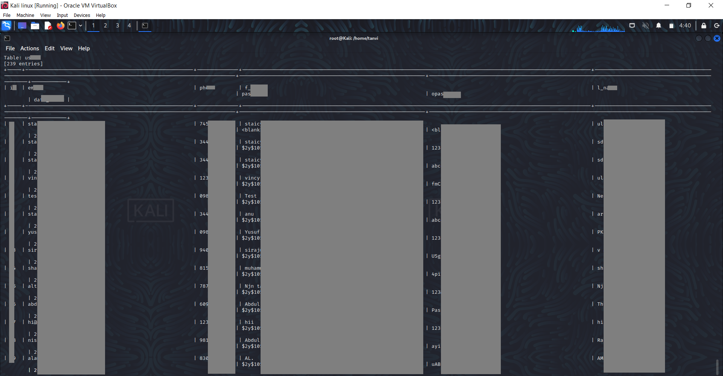

Slide 85
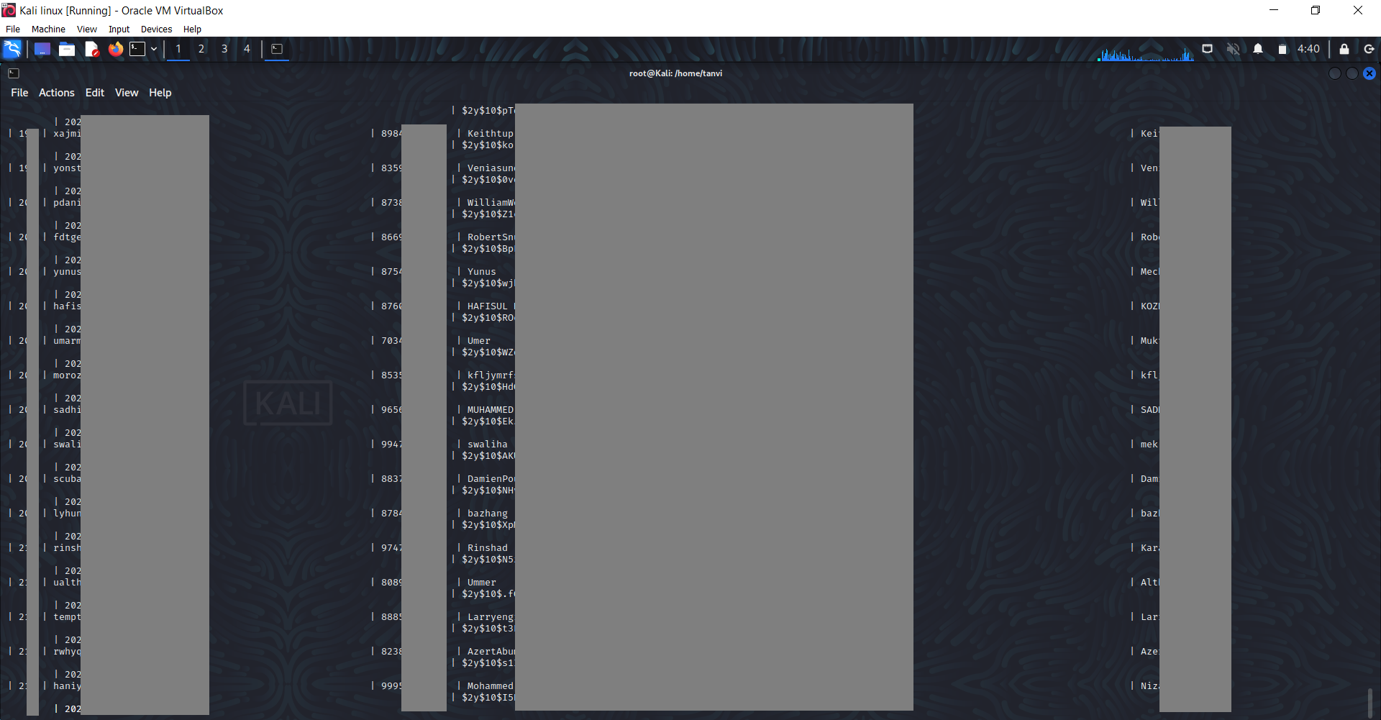

Slide 86


Slide 87

Step 9 :- Now select any name & password then go to LOGIN page and paste the details.

Slide 88

Step 10 :- Here we have successfully login in into the user account and can access it.

Slide 89

Step 11 :- Here we can also retrieve the payments table and can get the data of payments.

Slide 90


Slide 91


Slide 92


Slide 93
SQL Injection Preventions
Use Prepared Statements
Allow-list Input Validation
Continuous Scanning and Penetration Testing
Restrict Database Access

Slide 94

Target site
01
https://www.iphbooks.com/
IP Address :- 13.126.182.130
Vulnerability
02
Cross Site Scripting (XSS) – Reflected
Severity
03
High (https://bugcrowd.com/vulnerability-rating-taxonomy)
Impact
04
The attacker can hijack user accounts and steal the sensitive data. An attacker can also steal cookies and sessions.
Tools
05
Nmap , Google Incognito

Slide 95

Step 1 :- Visit :- https://www.iphbooks.com/

Slide 96

Step 2:- In this URL to write the malicious script: <script>alert(document.cookie)</script>.

Slide 97

Step 3:- And then Enter. Step 4:- As a result, we can see the popup box.

Slide 98

Step 5:- As a result, we can get the PHPSESSID then copy it.

Slide 99

Step 6:- Now go to new windows Incognito and open the site.

Slide 100

Step 7:- Then go to the login page.

Slide 101

Step 8:- Here right click on the page and select inspect then go to Application.

Slide 102

Step 9:- Now paste the PHPSESSID which we have copied and refresh the URL. Here we have login successfully without entering user ID and password.

Slide 103
Cross Site Scripting (XSS) Prevention
Output Encoding
Avoid Inserting Untrusted Data Except in Allowed Locations like HTML Entity and HTML Attribute etc..
Implement Input Validation
Use Security Headers

Slide 104
7.FUTURE SCOPE
The field of Vulnerability Assessment and Penetration Testing (VAPT) is continuously evolving with the rapid advancement of technology and the increasing complexity of cyber threats. As organizations grow more reliant on digital infrastructure, the need for robust security assessments becomes not just important but essential.
In the future, VAPT is expected to expand significantly across various domains such as cloud computing, Internet of Things (IoT), automotive systems, and industrial control systems. The growing adoption of artificial intelligence and machine learning in cybersecurity will further enhance the capabilities of automated vulnerability detection and real-time threat analysis.
Additionally, with the rise of zero-day vulnerabilities and advanced persistent threats (APTs), the demand for skilled penetration testers and ethical hackers will increase dramatically. This opens up numerous career opportunities in both government and private sectors for cybersecurity professionals.
Furthermore, the integration of VAPT practices into the software development lifecycle (DevSecOps) will ensure that security is embedded from the initial stages of development, making systems more resilient and secure by design.
Overall, the future of VAPT holds great potential not only as a proactive defense mechanism but also as a critical component of national and organizational security. Continued research, innovation, and education in this area will be vital to staying ahead of evolving cyber threats.

Slide 105
8.REFERENCES
William Stallings, Network Security Essentials: Applications and Standards, Pearson Education, 6th Edition, 2023.
Dafydd Stuttard and Marcus Pinto, The Web Application Hacker’s Handbook: Finding and Exploiting Security Flaws, Wiley, 2nd Edition, 2011.
Georgia Weidman, Penetration Testing: A Hands-On Introduction to Hacking, No Starch Press, 2014.
OWASP Foundation. “OWASP Testing Guide.” https://owasp.org
Offensive Security. “Kali Linux Tools Documentation.” https://tools.kali.org
NIST Special Publication 800-115: Technical Guide to Information Security Testing and Assessment, National Institute of Standards and Technology.

Slide 106
Metasploit Unleashed - Offensive Security. https://www.offensivesecurity.com/metasploit-unleashed/
Scapy Documentation. https://scapy.readthedocs.io
Rapid7. “Understanding Vulnerability Scanning & Penetration Testing.”
https://www.rapid7.com
Bhardwaj, Ajay. Cyber Security & Ethical Hacking, Khanna Publishing, 2021.

Slide 107
Thank you

